Slide 1
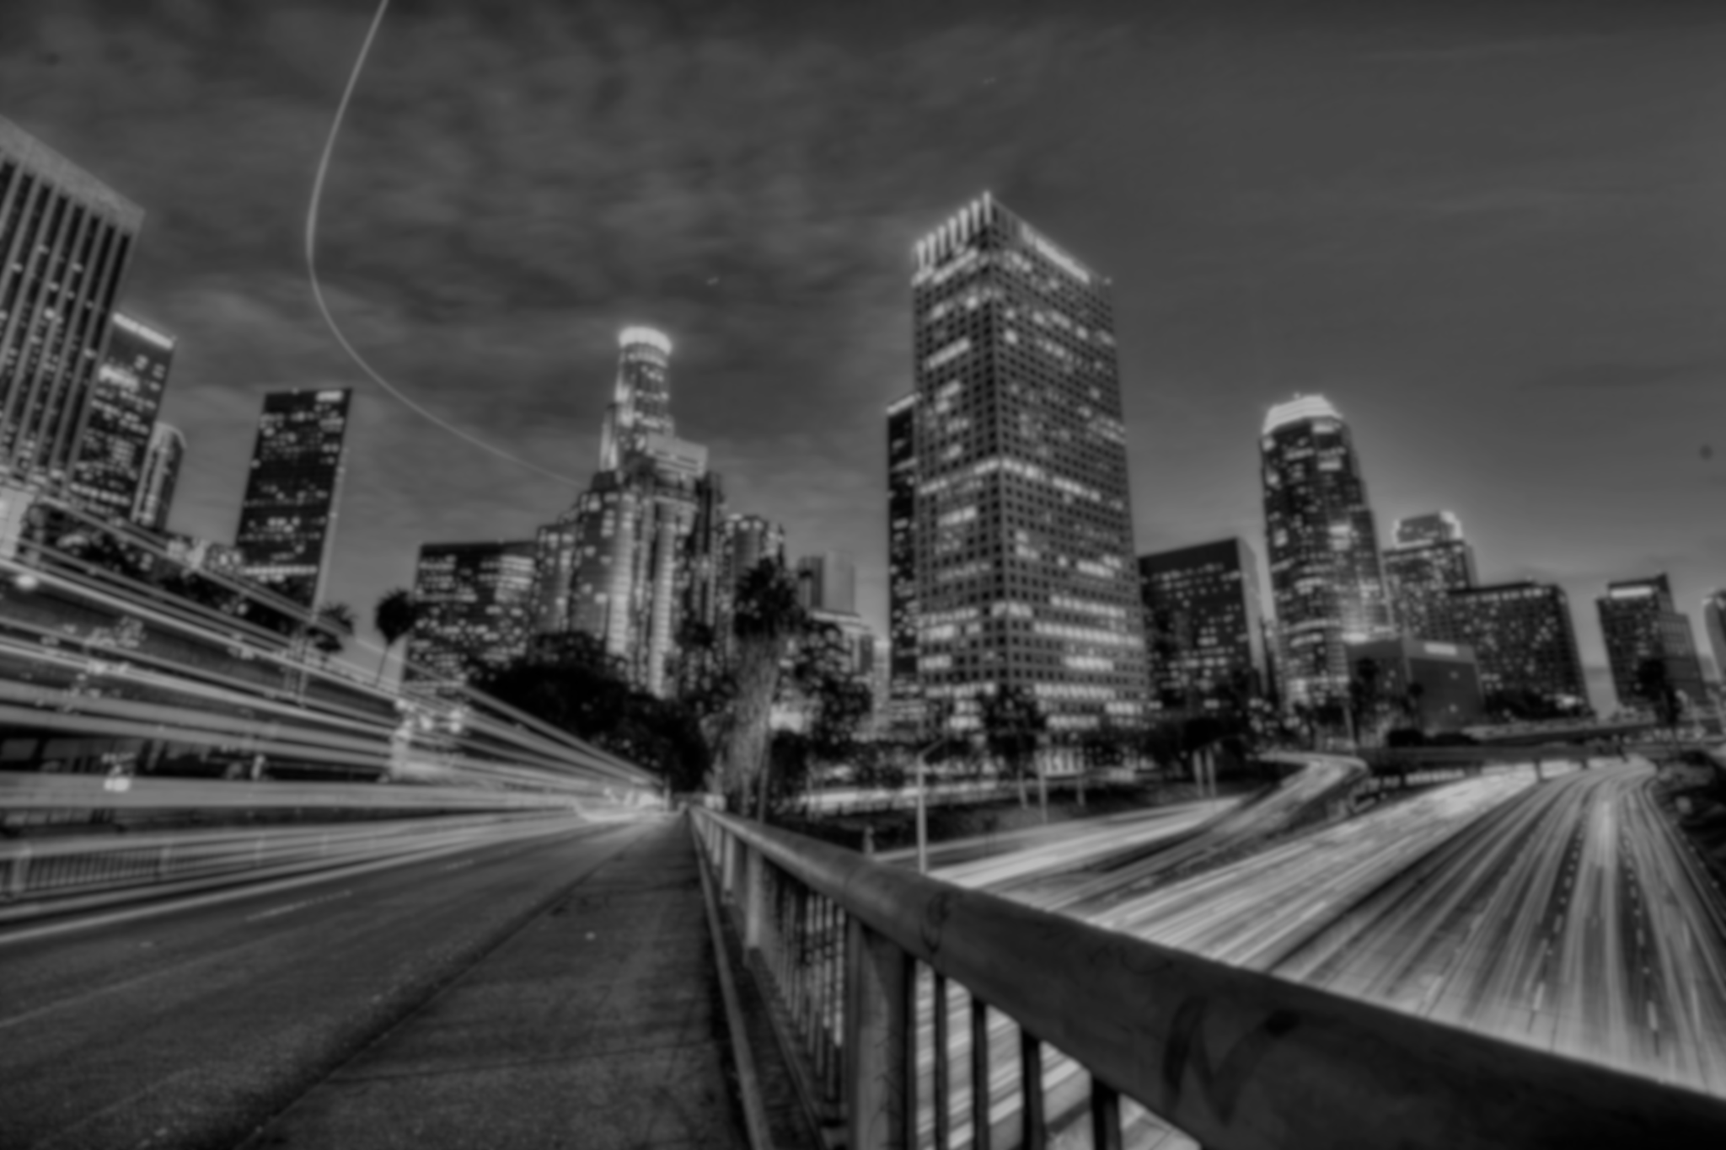
Data Analytics
311 Reports
Smart LA Project
Imaad Khan; Peipei Han; Shuhan Zhou;
Yifan Wu; Yuzhou Dou

Slide 2
AGENDA
Basic
Distribution
Time Series
Efficiency
Map with
Real-time data
Smart LA
Suggestions

Slide 3

Basic
Distribution
01

Slide 4
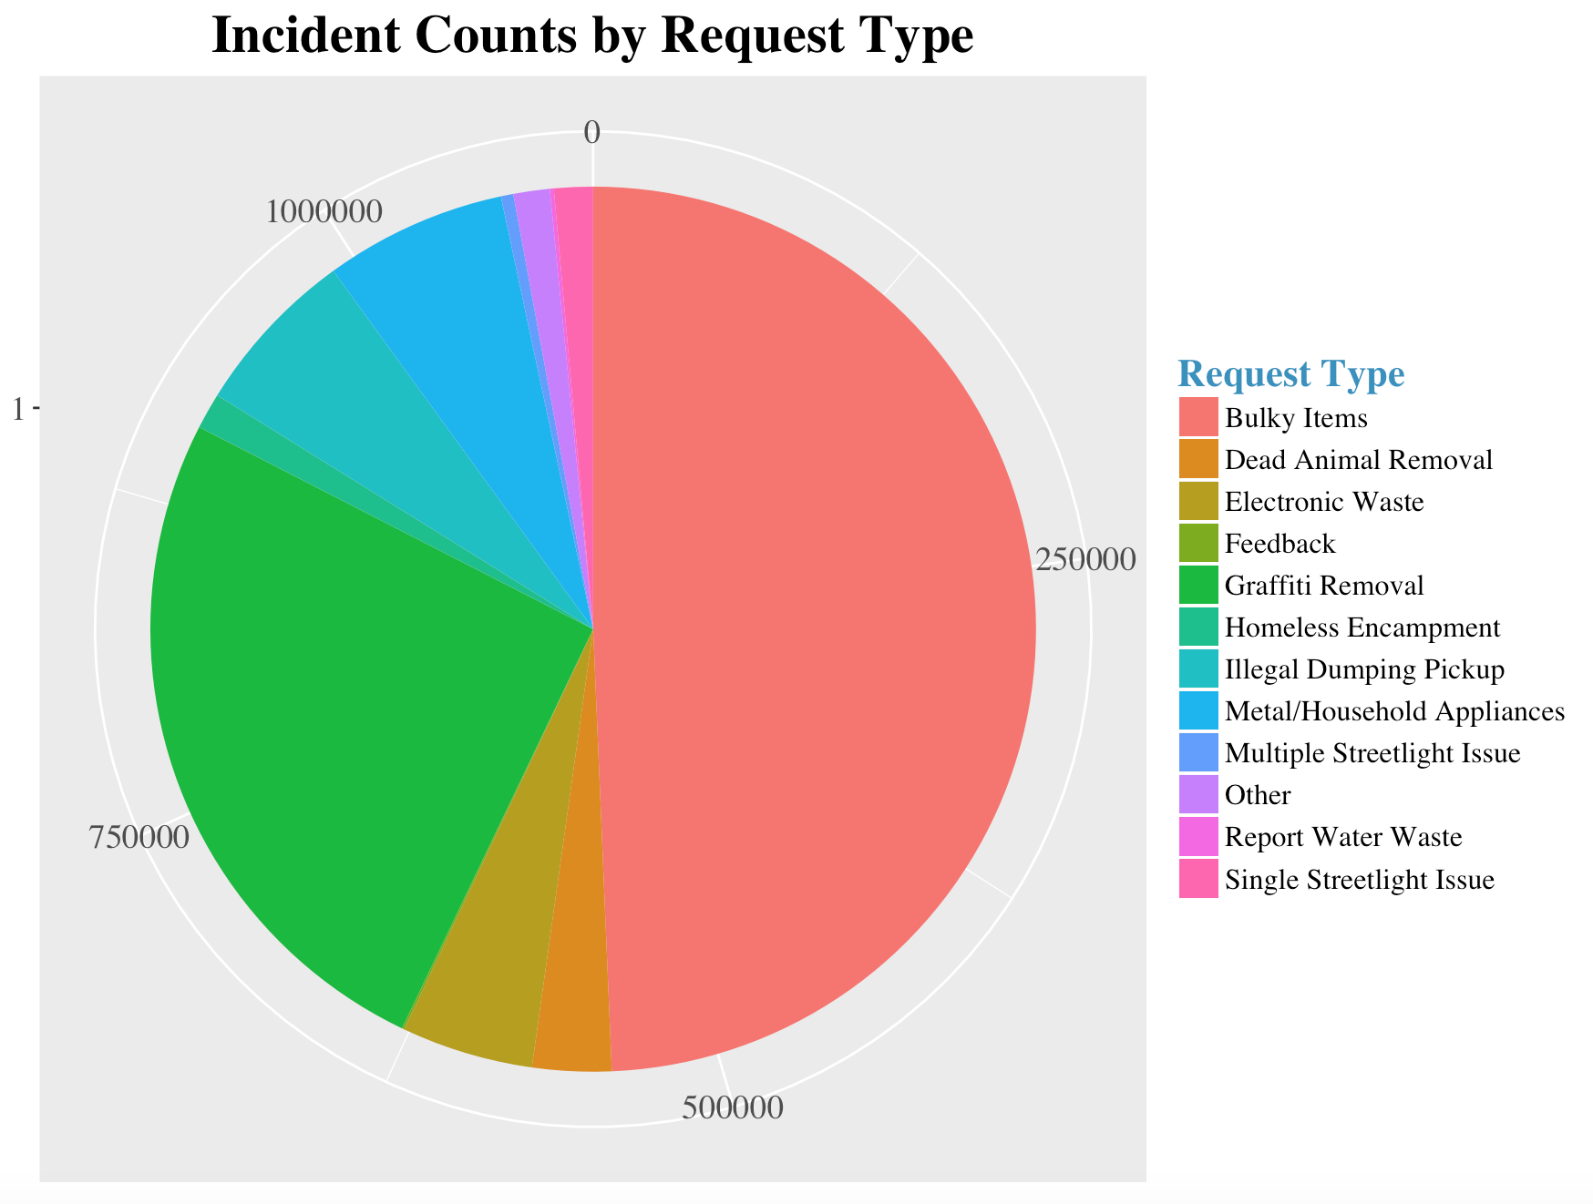
Request Type Distribution
1
Basic
Distribution
2
Time Series
Efficiency
3
Map with
Real-time Data
4
Smart LA
Suggestions

Slide 5
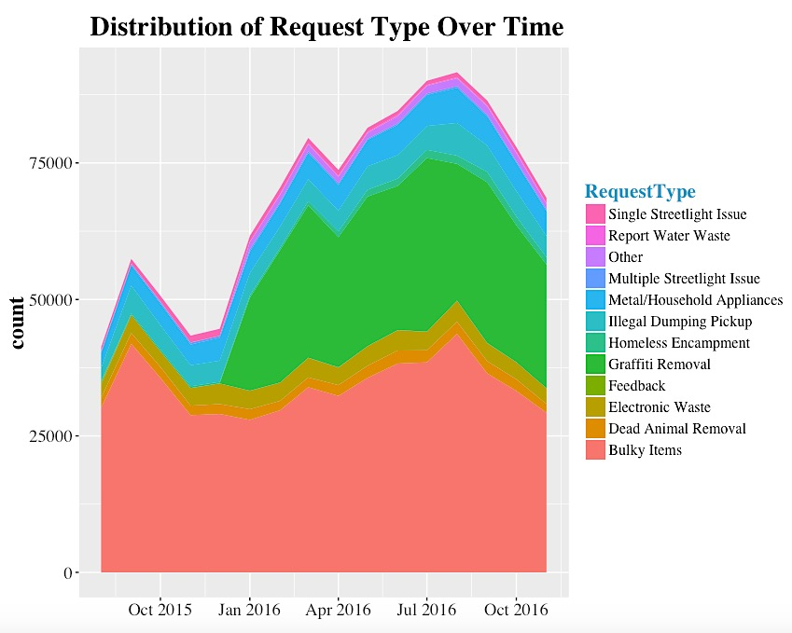
Request Type Distribution
1
Basic
Distribution
2
Time Series
Efficiency
3
Map with
Real-time Data
4
Smart LA
Suggestions

Slide 6
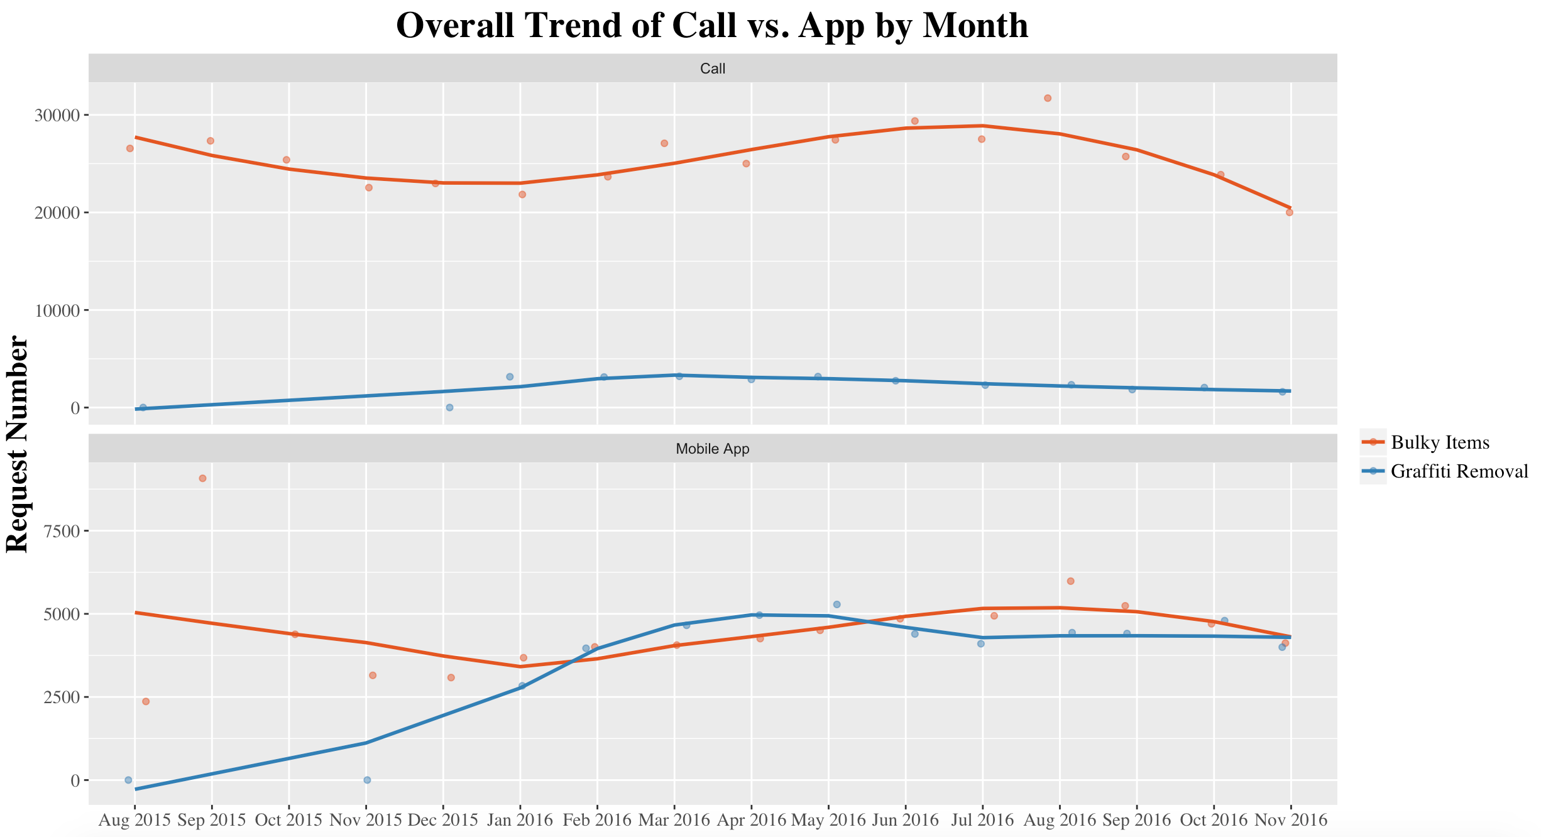
Trend of Request Source
1
Basic
Distribution
2
Time Series
Efficiency
3
Map with
Real-time Data
4
Smart LA
Suggestions

Slide 7
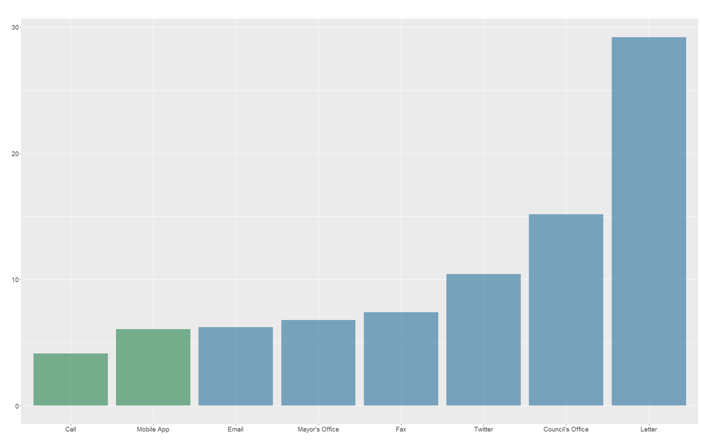
Handle Time by Sources
Handle Time by Request Source
1
Basic
Distribution
2
Time Series
Efficiency
3
Map with
Real-time Data
4
Smart LA
Suggestions

Slide 8
Time Series
Efficiency
02

Slide 9
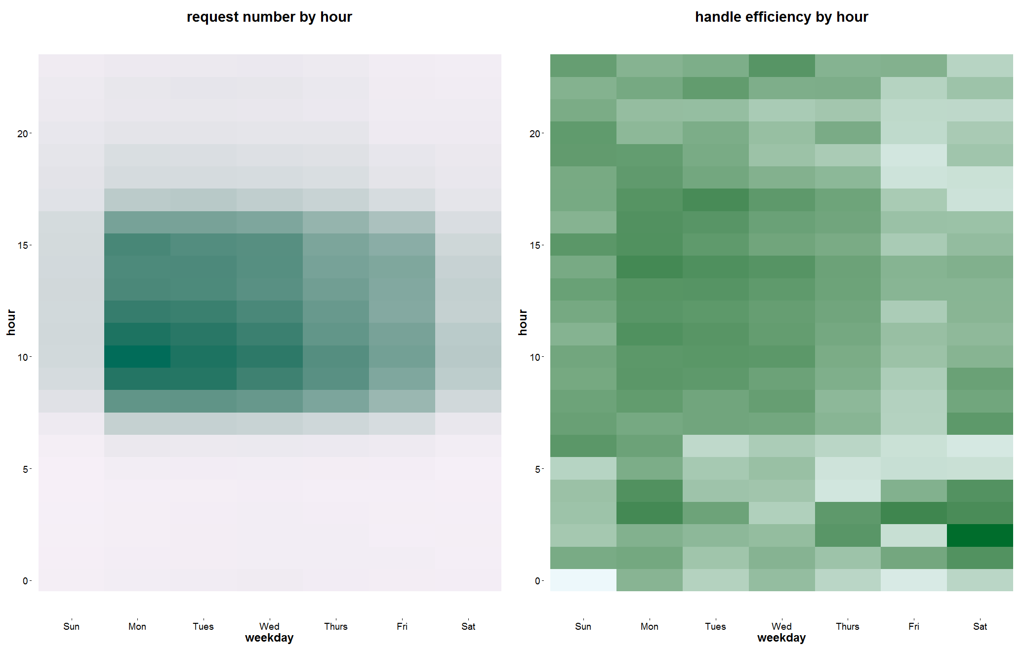
Requests and Handle Time
Request Number by Hour
Handle Time by Hour
1
Basic
Distribution
2
Time Series
Efficiency
3
Map with
Real-time Data
4
Smart LA
Suggestions

Slide 10
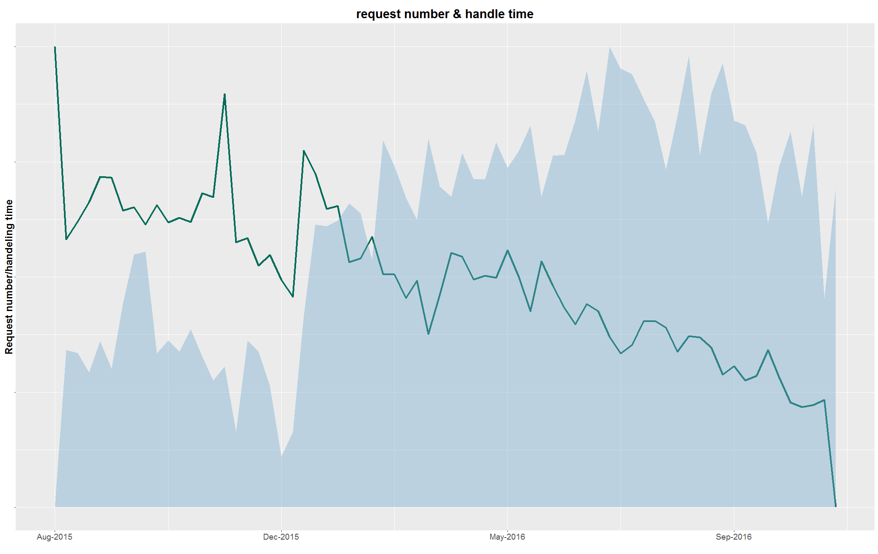
Requests and Handle Time
Request Number & Handle Time
1
Basic
Distribution
2
Time Series
Efficiency
3
Map with
Real-time Data
4
Smart LA
Suggestions

Slide 11
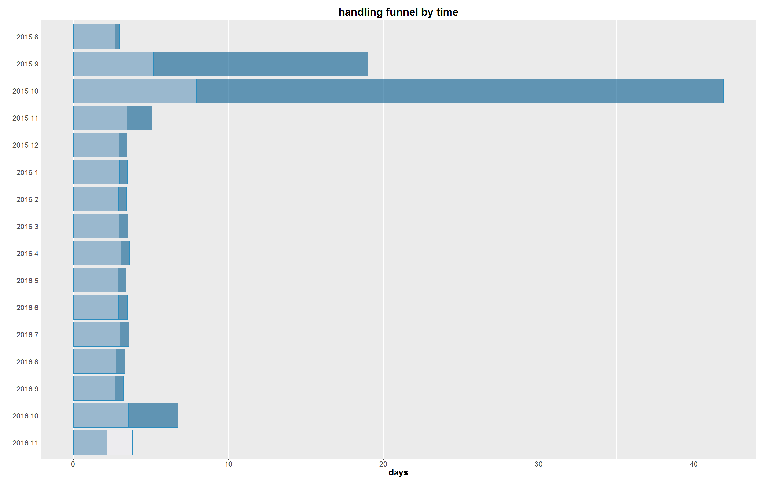
Time Series of Efficiency
Handling Funnel by Time
Handling Funnel by Month
1
Basic
Distribution
2
Time Series
Efficiency
3
Map with
Real-time Data
4
Smart LA
Suggestions

Slide 12
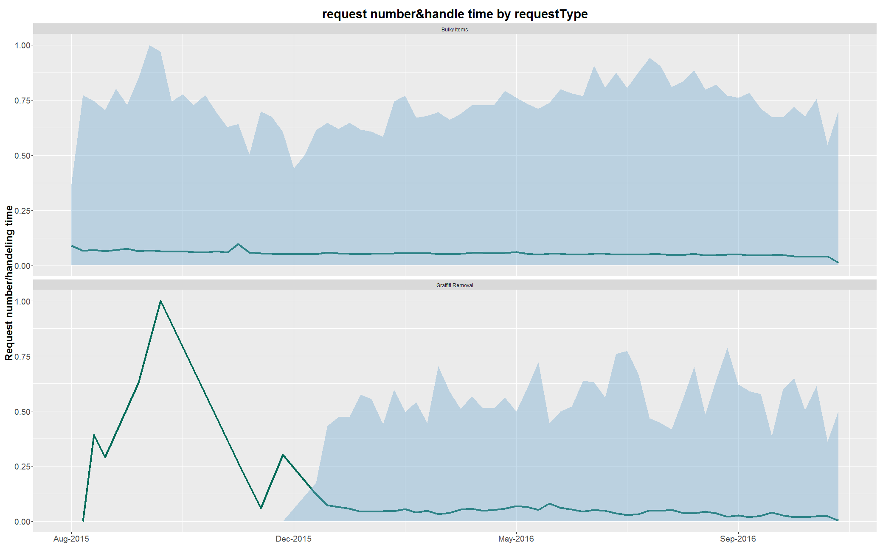
Efficiency: Request Type Breakdown
Request Number & Handle Time by Request Type
1
Basic
Distribution
2
Time Series
Efficiency
3
Map with
Real-time Data
4
Smart LA
Suggestions

Slide 13
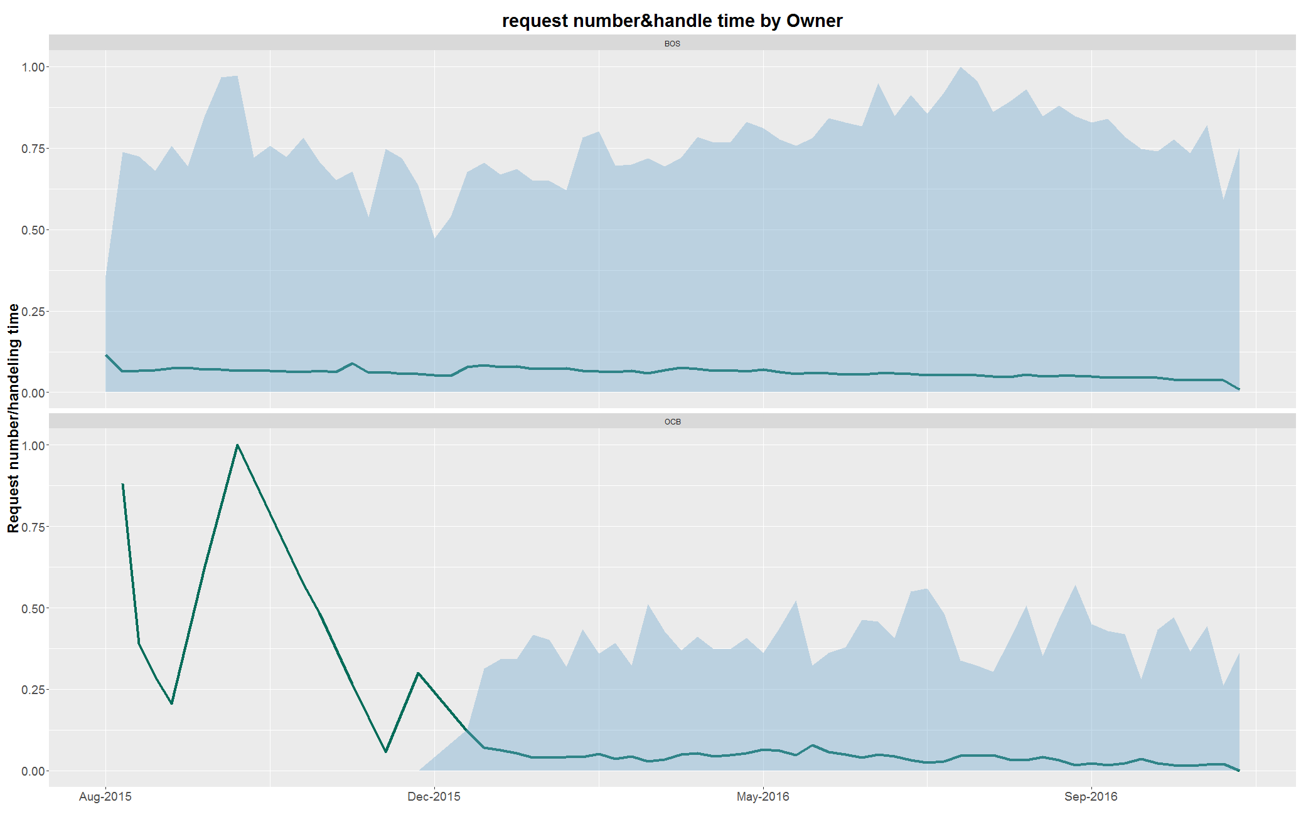
Efficiency: Owner Breakdown
Request Number & Handle Time by Owner
1
Basic
Distribution
2
Time Series
Efficiency
3
Map with
Real-time Data
4
Smart LA
Suggestions

Slide 14
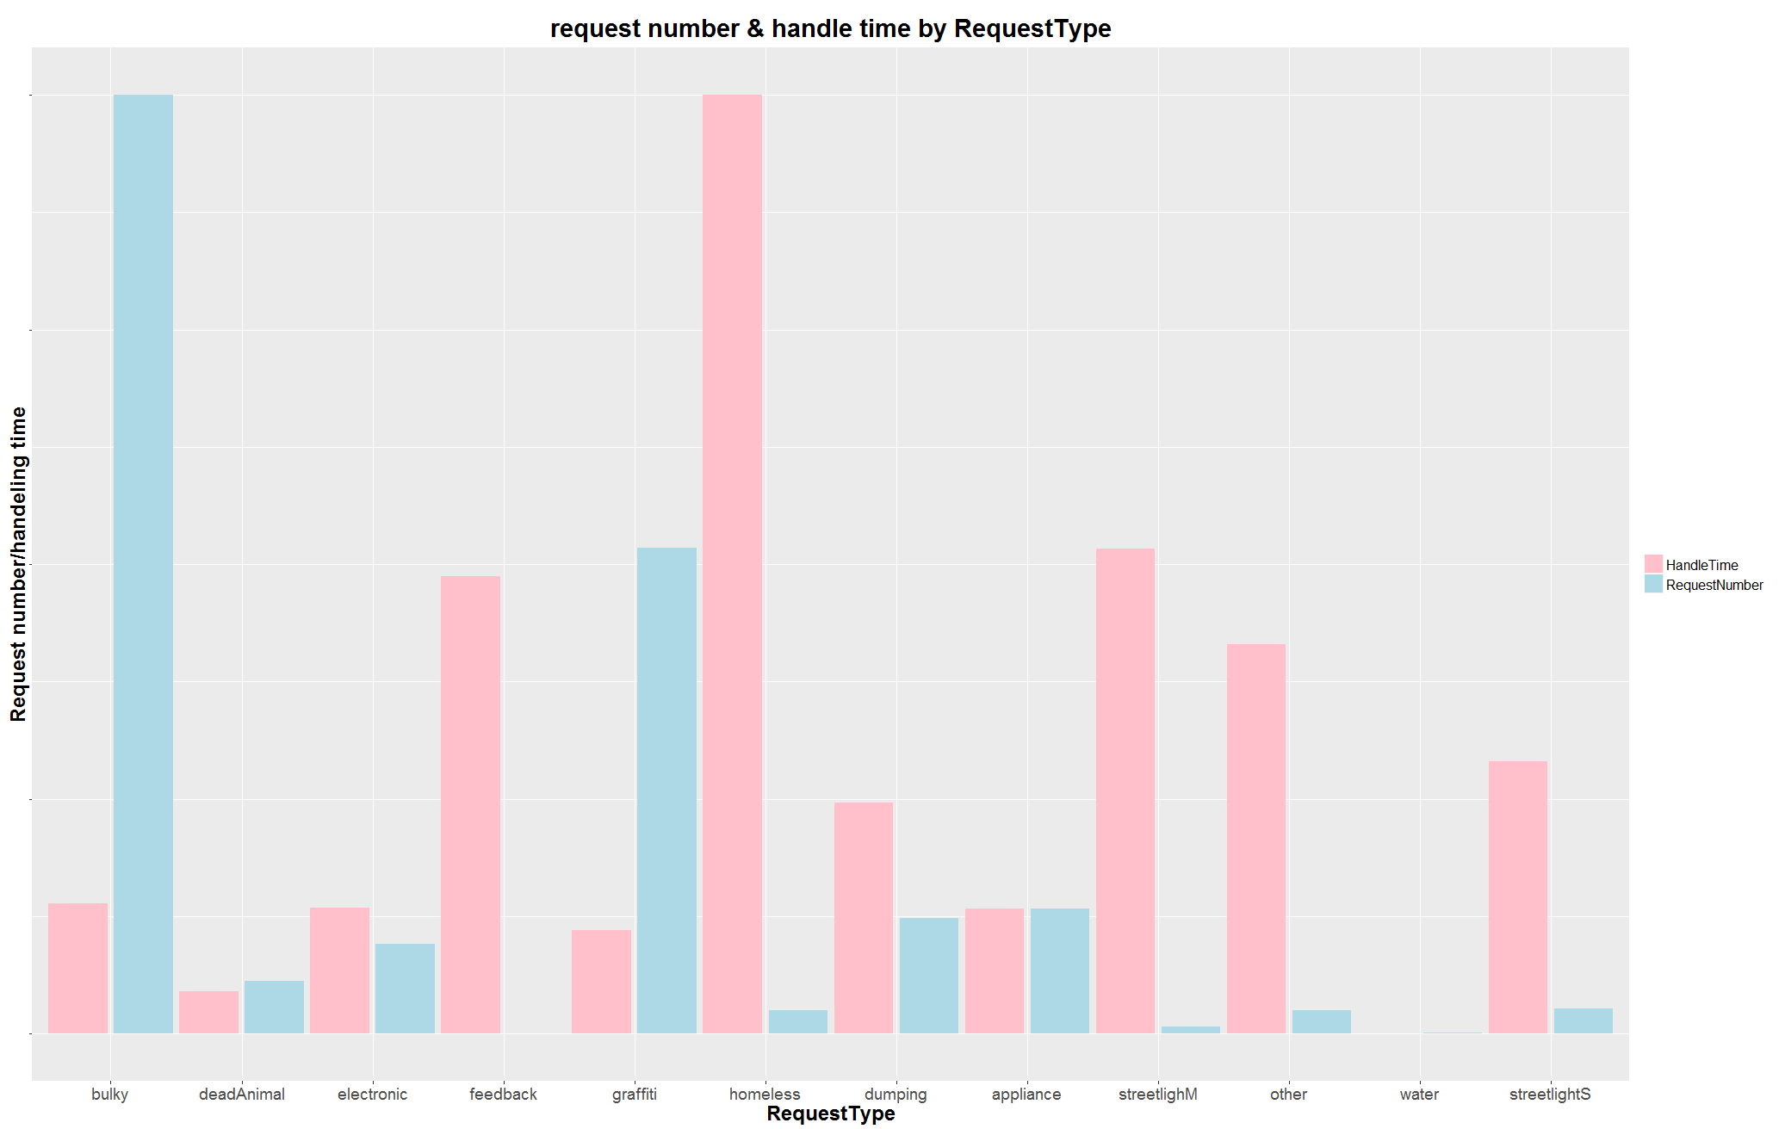
Efficiency: Request Type
Request Number & Handle Time by Request Type
1
Basic
Distribution
2
Time Series
Efficiency
3
Map with
Real-time Data
4
Smart LA
Suggestions

Slide 15
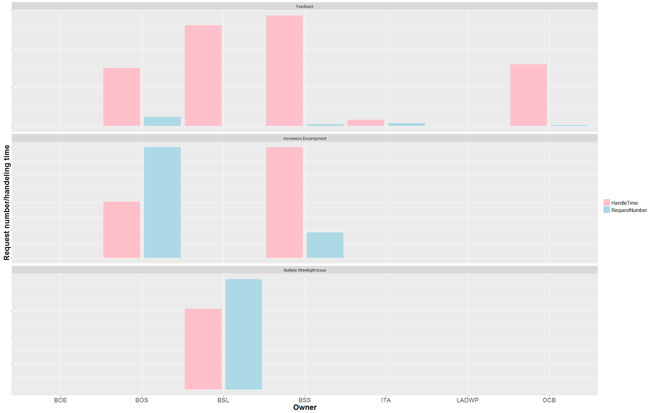
Efficiency: Request Type and Owner
Request Number & Handle Time by Request Type and Owner
1
Basic
Distribution
2
Time Series
Efficiency
3
Map with
Real-time Data
4
Smart LA
Suggestions

Slide 16
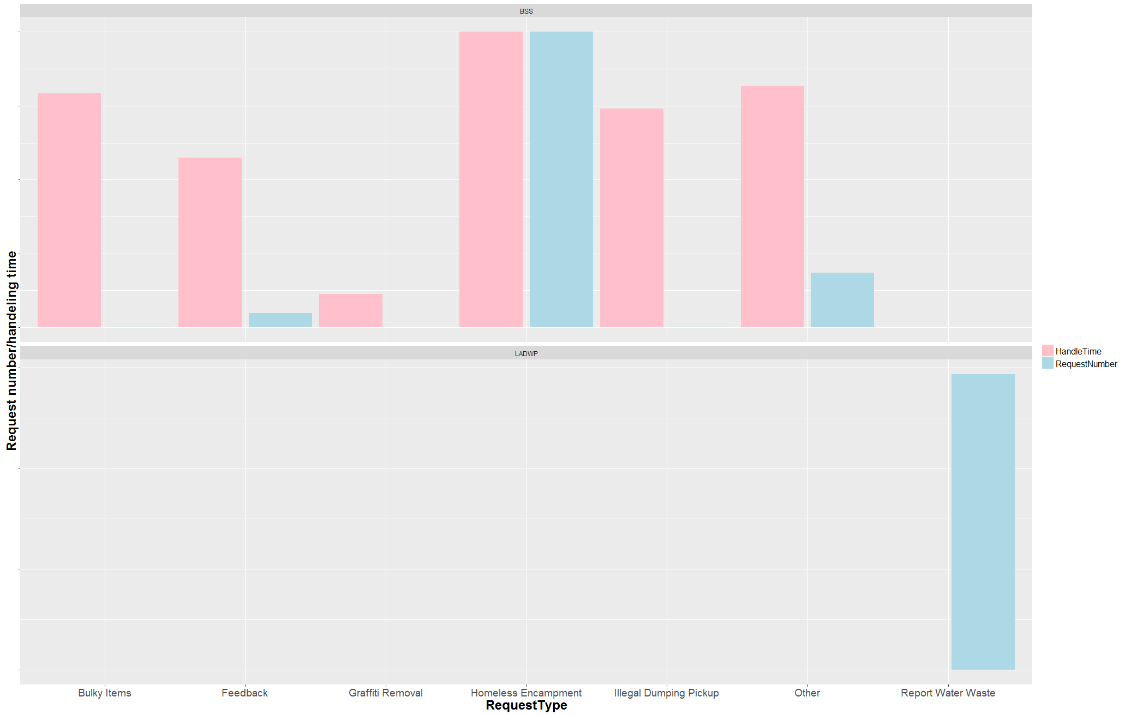
Efficiency: Request Type and Owner
Request Number & Handle Time by Request Type
1
Basic
Distribution
2
Time Series
Efficiency
3
Map with
Real-time Data
4
Smart LA
Suggestions

Slide 17
Map with
Real-time Data
03

Slide 18
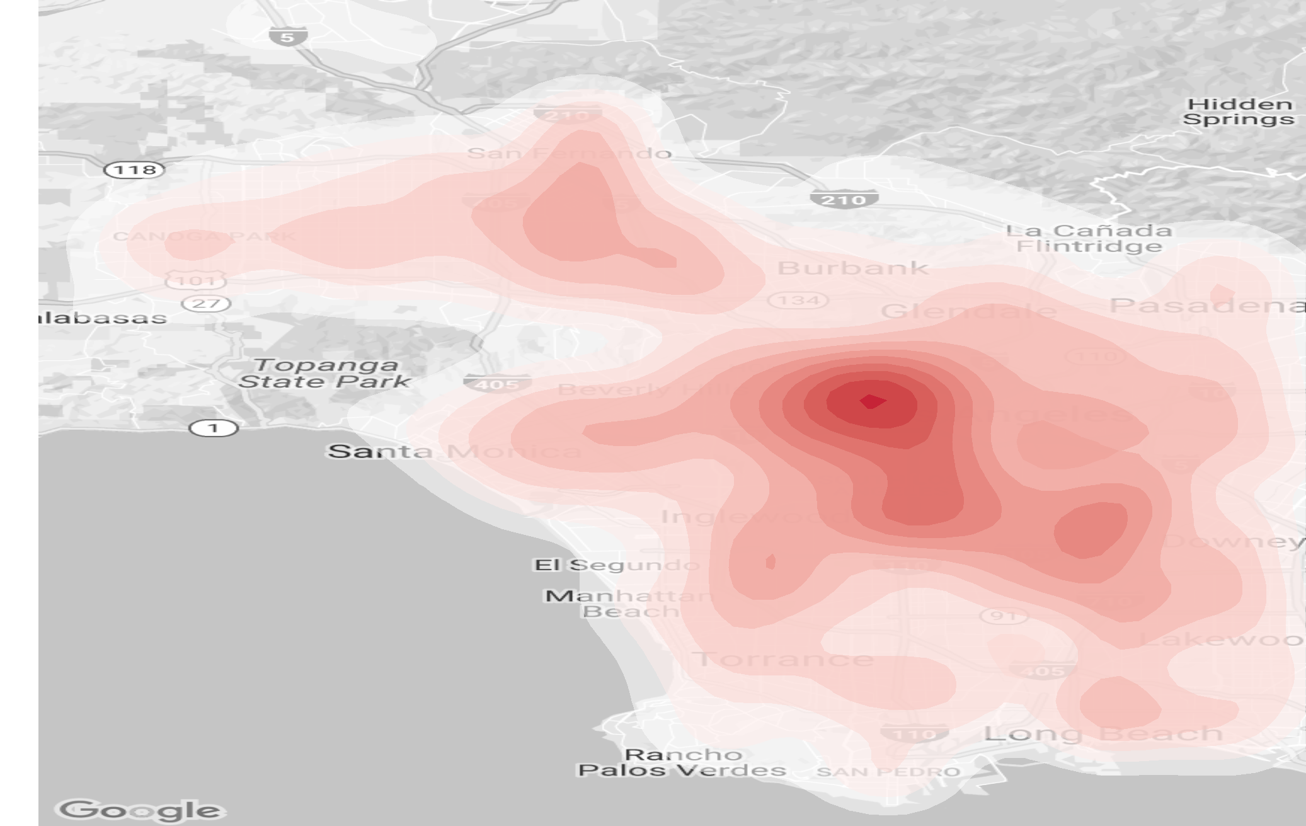
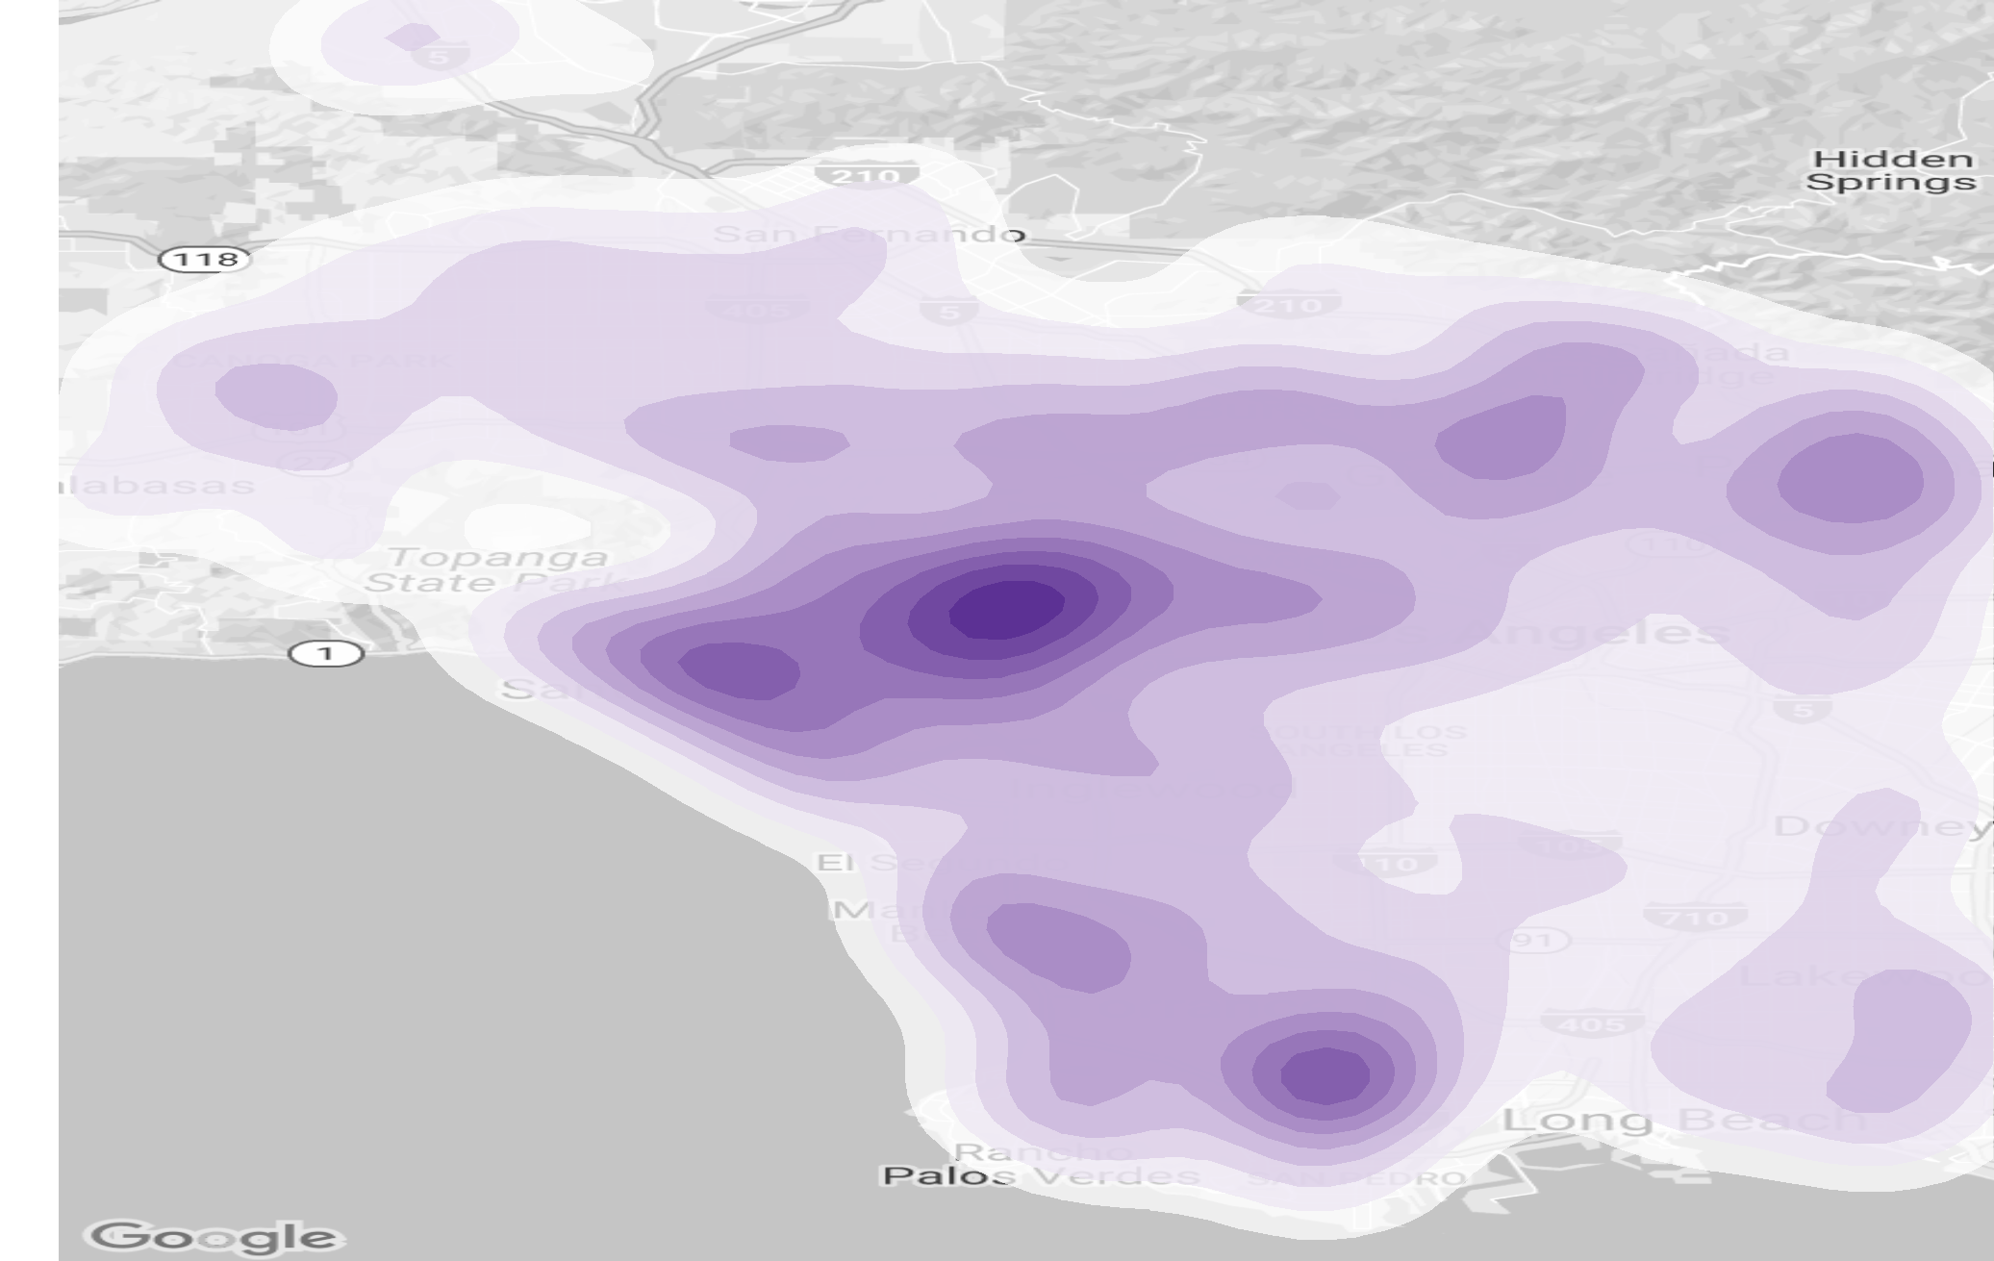
Background Maps
Population Contour
Income Contour
1
Basic
Distribution
2
Time Series
Efficiency
3
Map with
Real-time Data
4
Smart LA
Suggestions

Slide 19
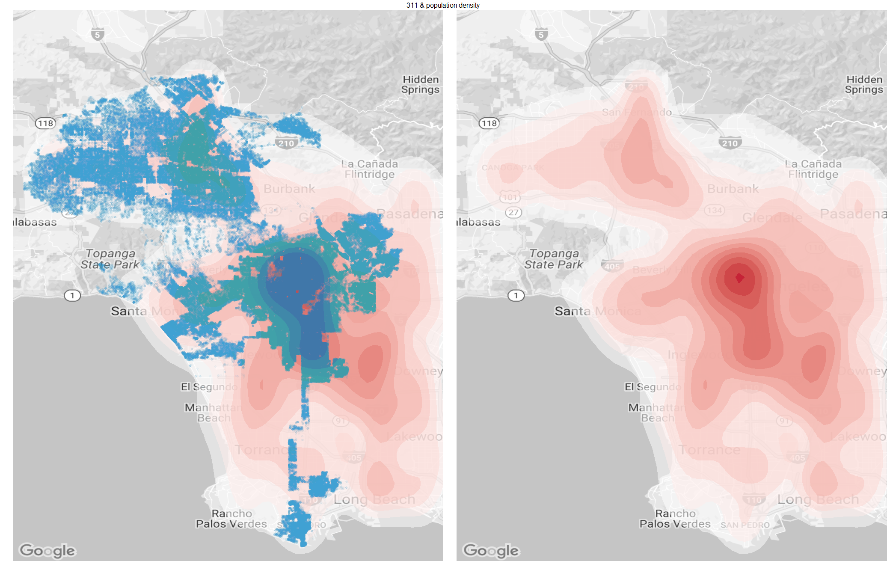
General Pattern – Population
311 & Population Density
1
Basic
Distribution
2
Time Series
Efficiency
3
Map with
Real-time Data
4
Smart LA
Suggestions

Slide 20
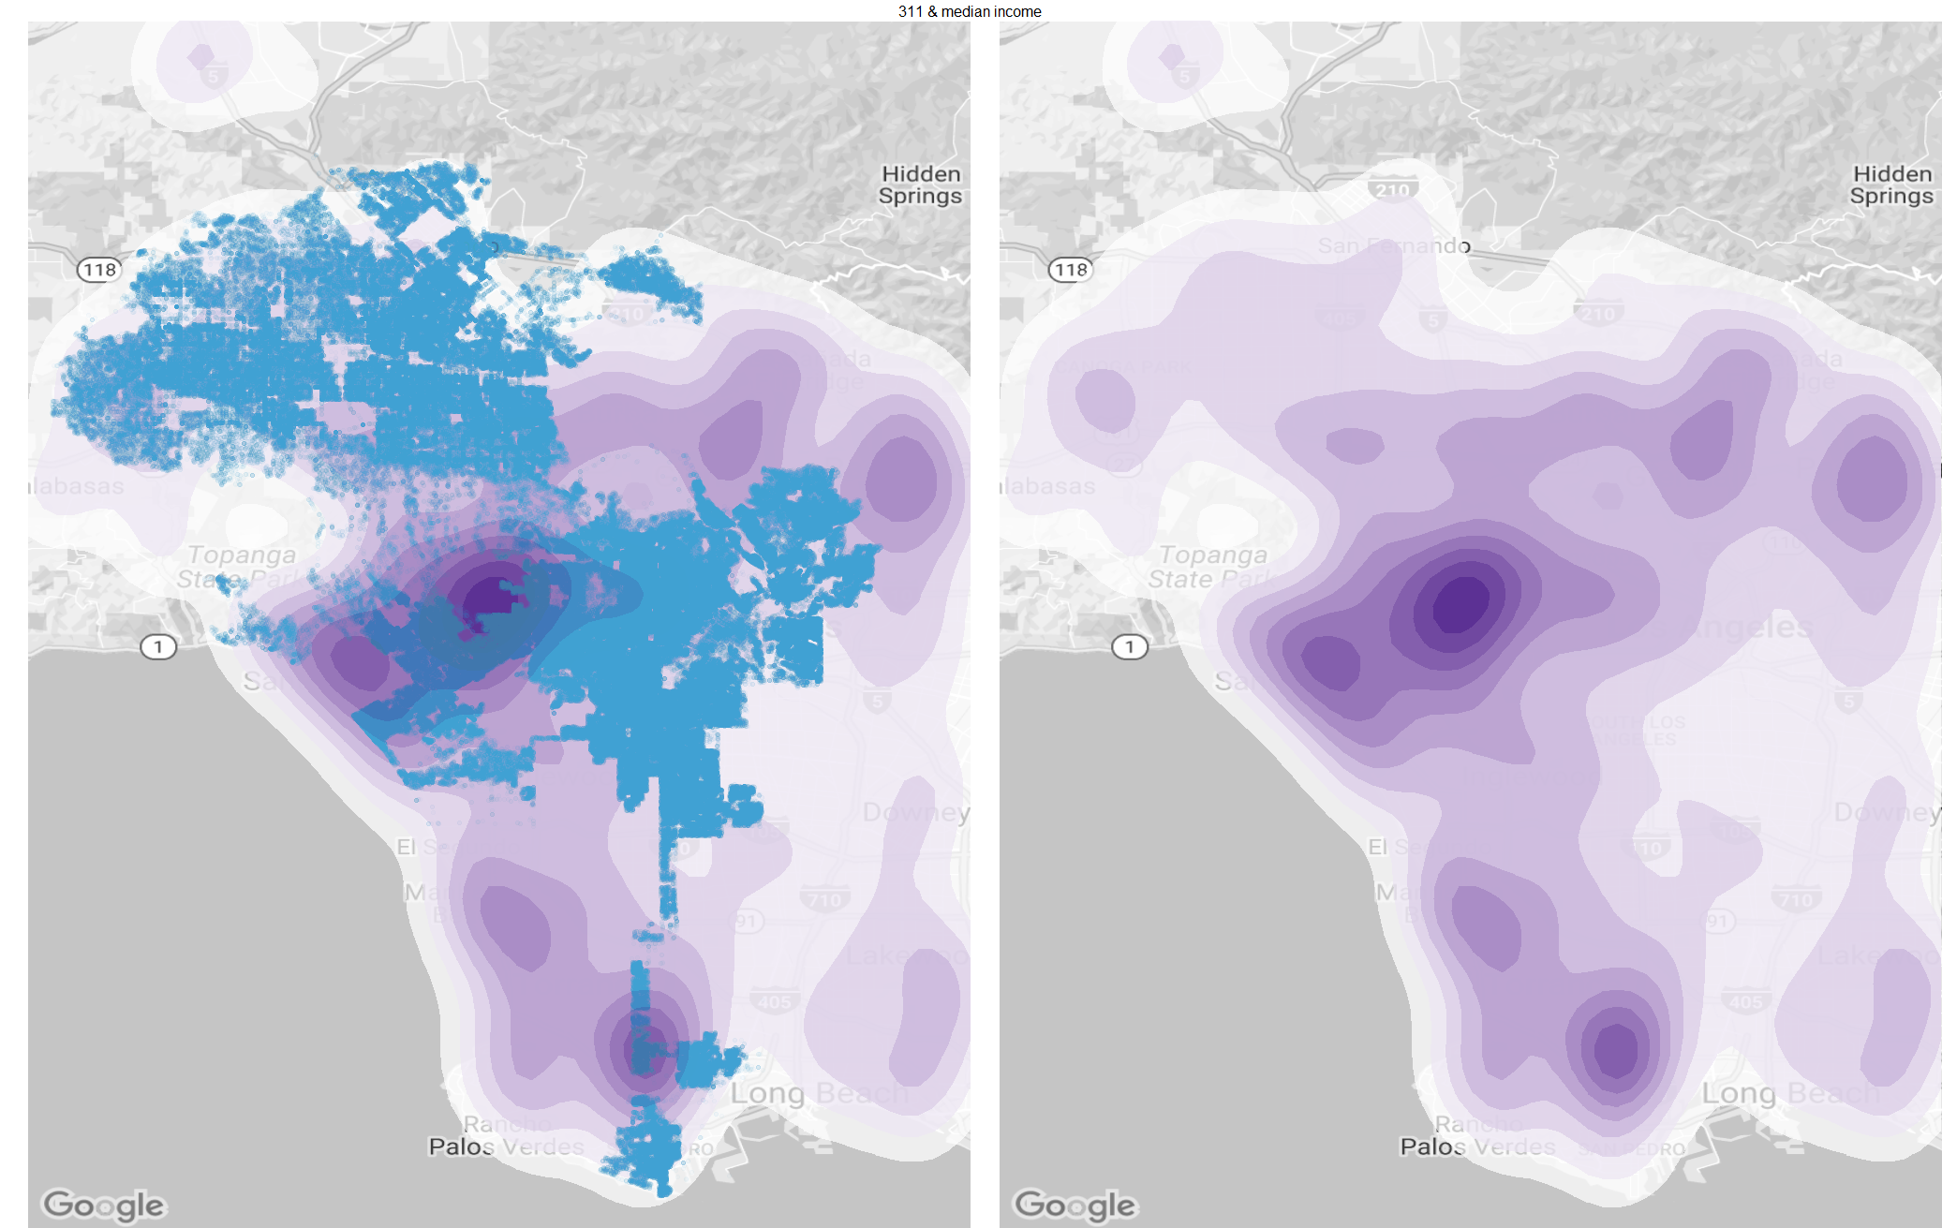
na
General Pattern – Income
General Pattern – Income
311 & Median Income
1
Basic
Distribution
2
Time Series
Efficiency
3
Map with
Real-time Data
4
Smart LA
Suggestions

Slide 21
na
Abnormality
311 & Population Density
1
Basic
Distribution
2
Time Series
Efficiency
3
Map with
Real-time Data
4
Smart LA
Suggestions

Slide 22
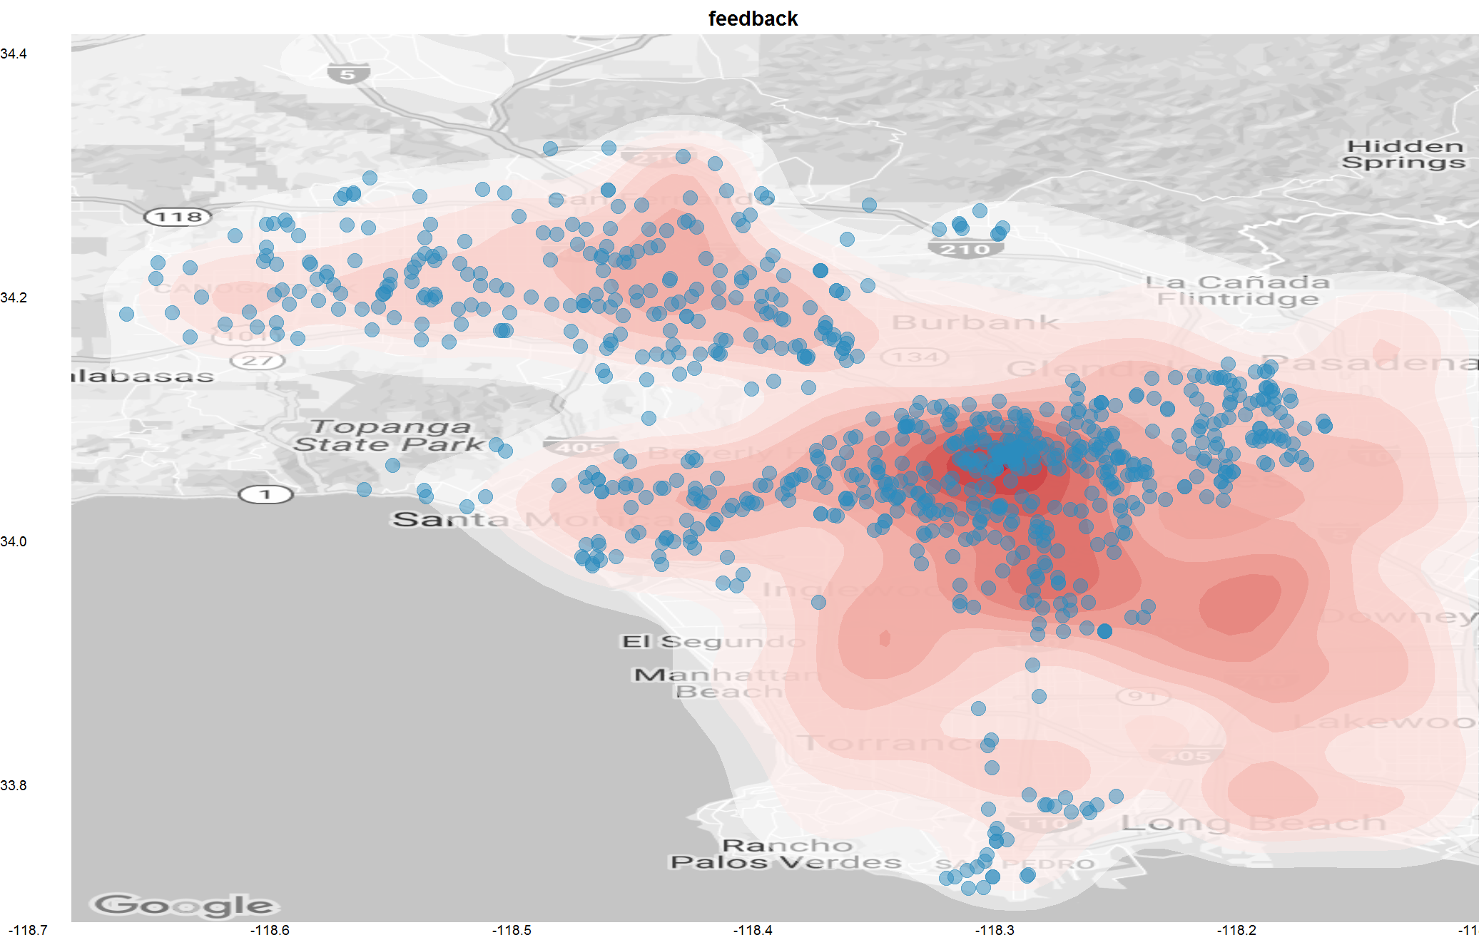
na
General Pattern - Feedback
Feedbacks & Population Density
1
Basic
Distribution
2
Time Series
Efficiency
3
Map with
Real-time Data
4
Smart LA
Suggestions

Slide 23
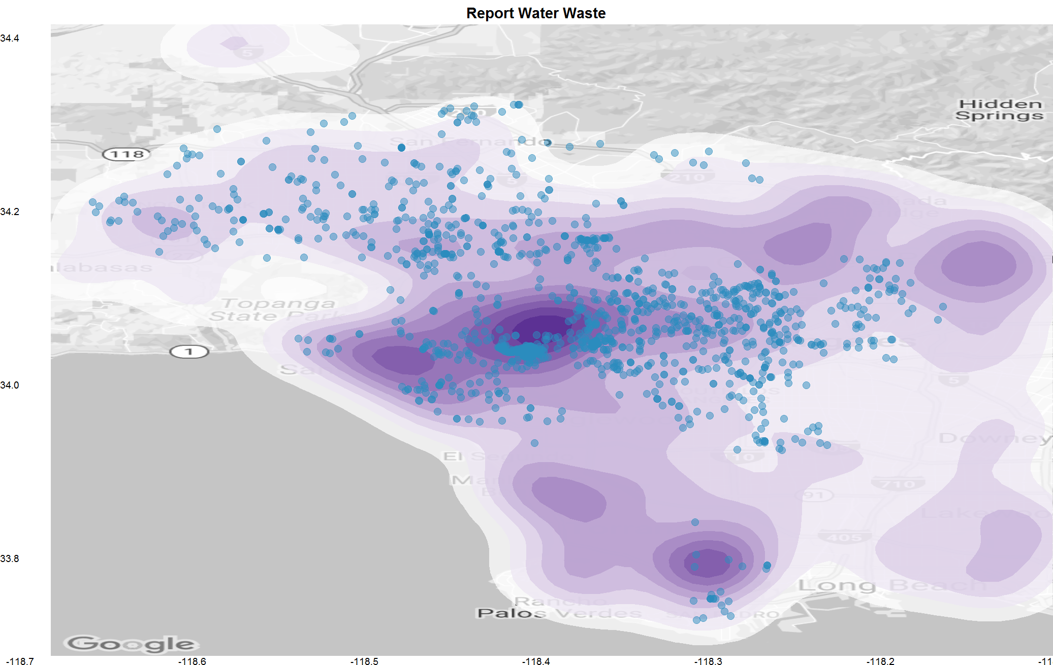
na
General Pattern - Water Waste
1
Basic
Distribution
2
Time Series
Efficiency
3
Map with
Real-time Data
4
Smart LA
Suggestions

Slide 24
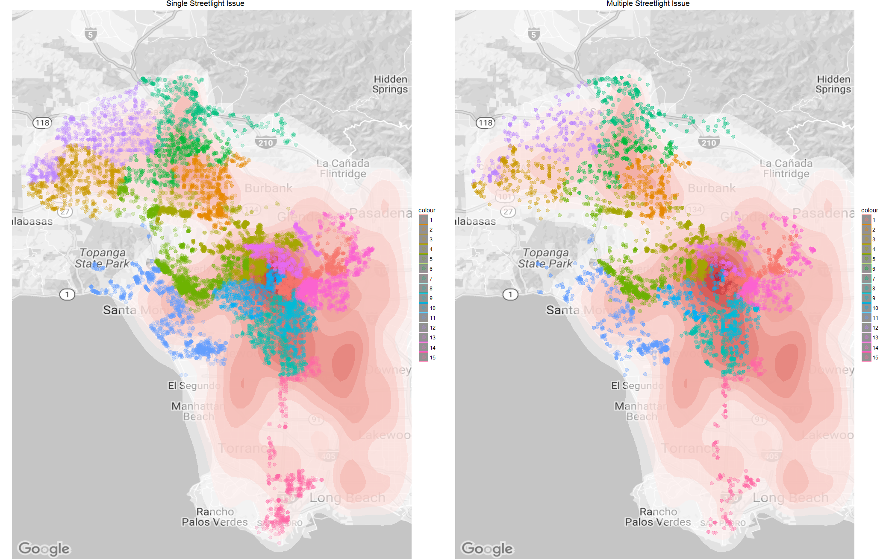
na
Special Features – Streetlight
1
Basic
Distribution
2
Time Series
Efficiency
3
Map with
Real-time Data
4
Smart LA
Suggestions

Slide 25
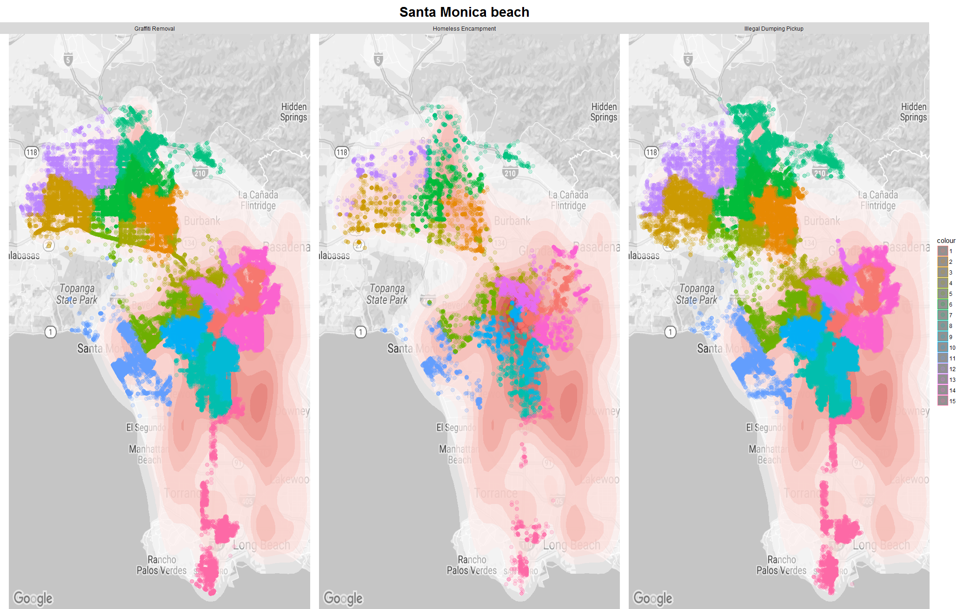
na
Special Features – Tourist Resort
1
Basic
Distribution
2
Time Series
Efficiency
3
Map with
Real-time Data
4
Smart LA
Suggestions

Slide 26
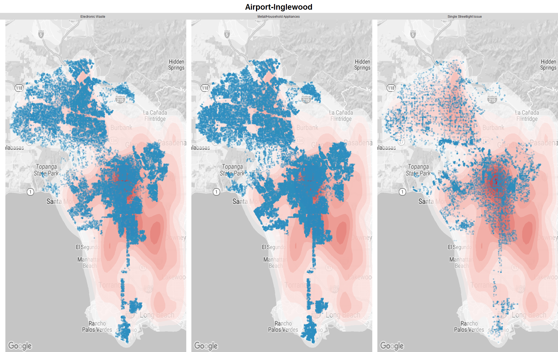
na
Special Features – Airport Area
1
Basic
Distribution
2
Time Series
Efficiency
3
Map with
Real-time Data
4
Smart LA
Suggestions

Slide 27
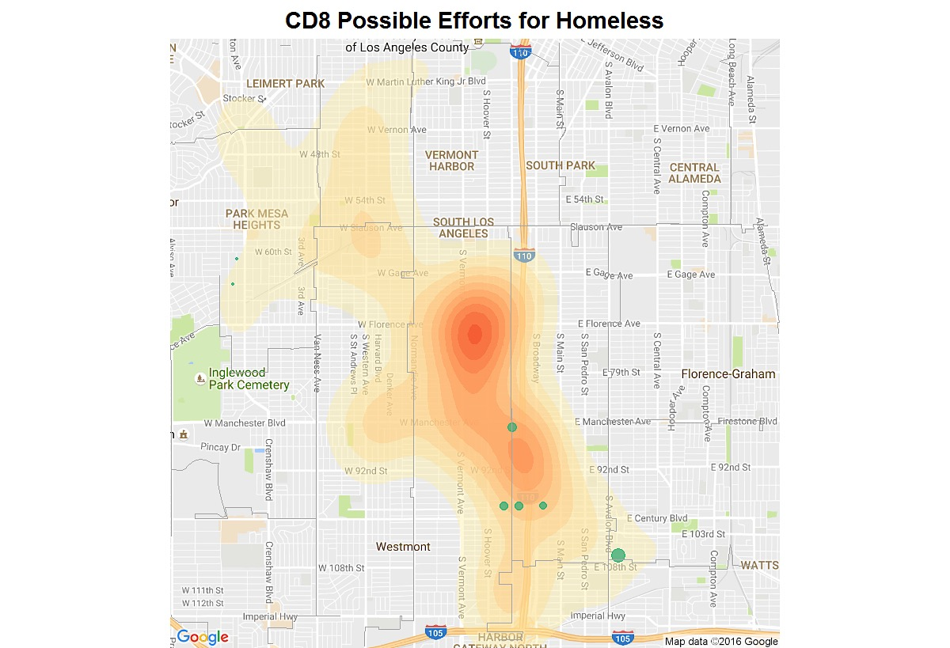
Homeless Shelter Planning
CD8 Possible Efforts for Homeless People
1
Basic
Distribution
2
Time Series
Efficiency
3
Map with
Real-time Data
4
Smart LA
Suggestions

Slide 28
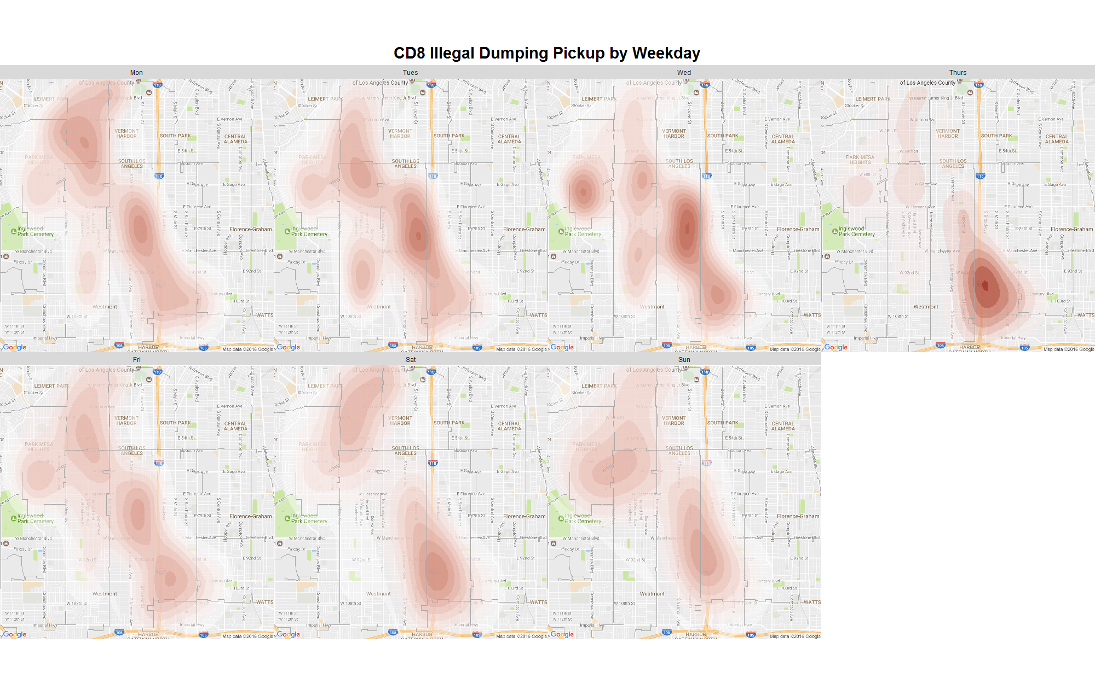
Dumping
Dumping Issue
CD8 Illegal Dumping Pickup Reports by Weekday
1
Basic
Distribution
2
Time Series
Efficiency
3
Map with
Real-time Data
4
Smart LA
Suggestions

Slide 29
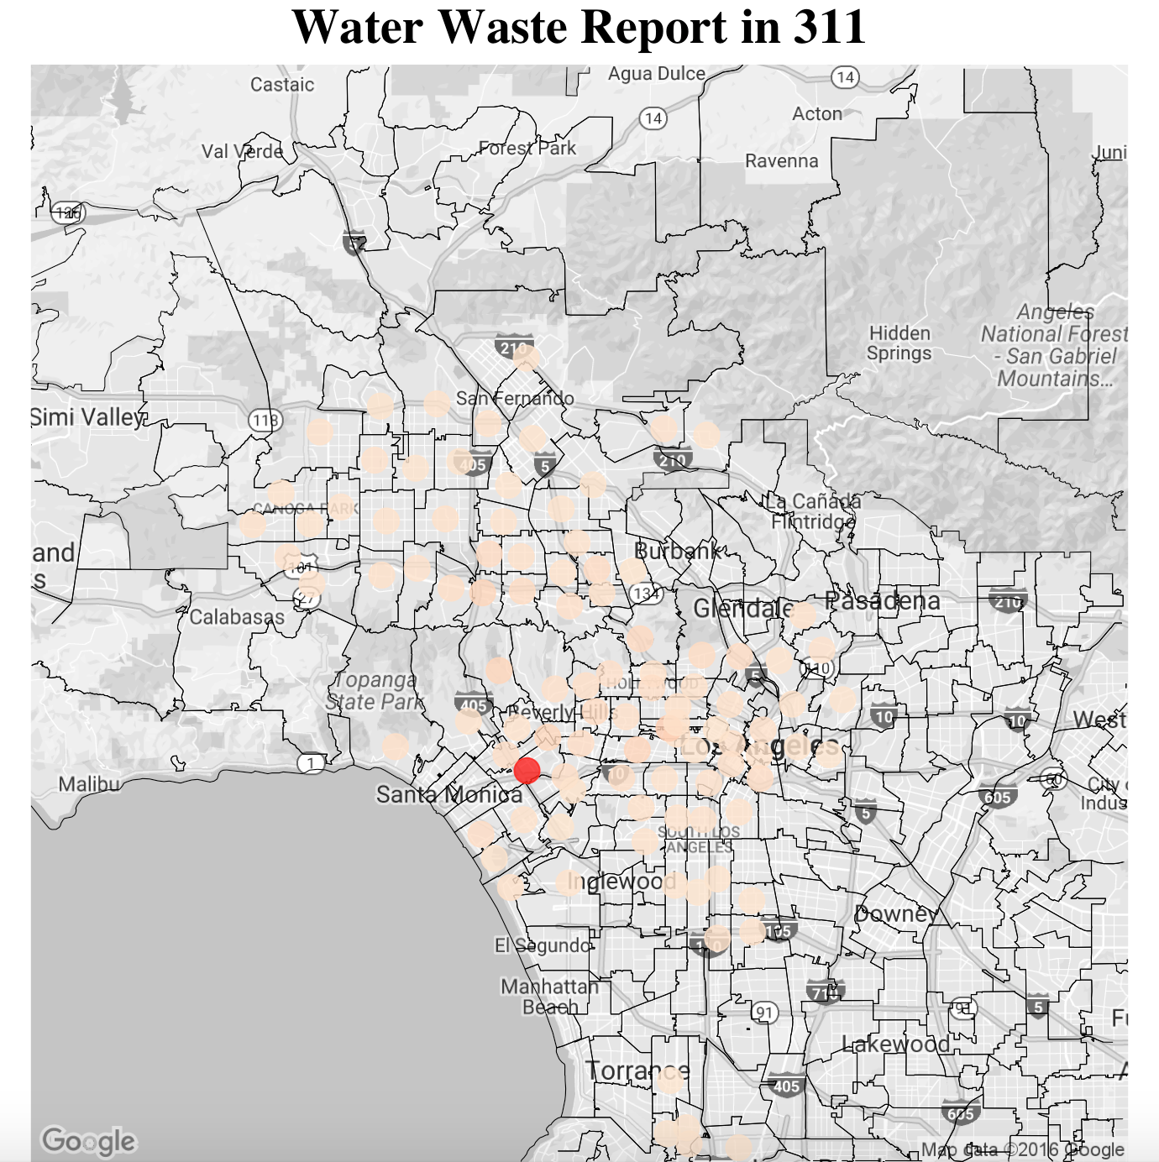
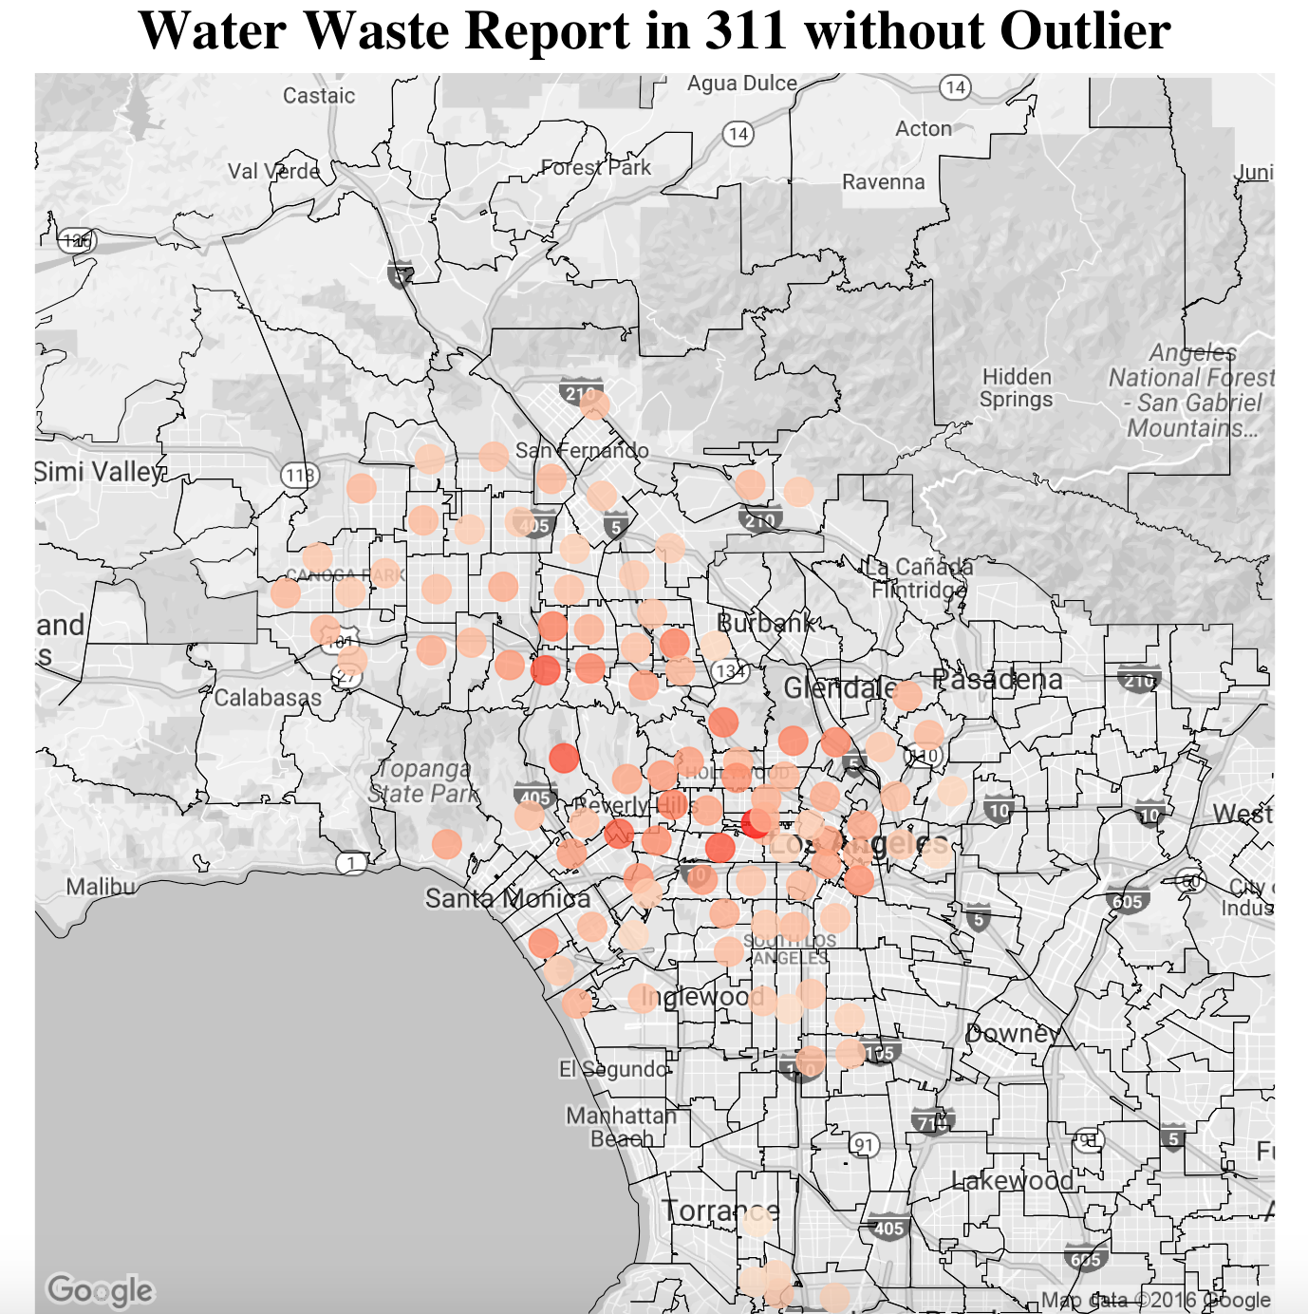
Water Waste Analysis
1
Basic
Distribution
2
Time Series
Efficiency
3
Map with
Real-time Data
4
Smart LA
Suggestions

Slide 30
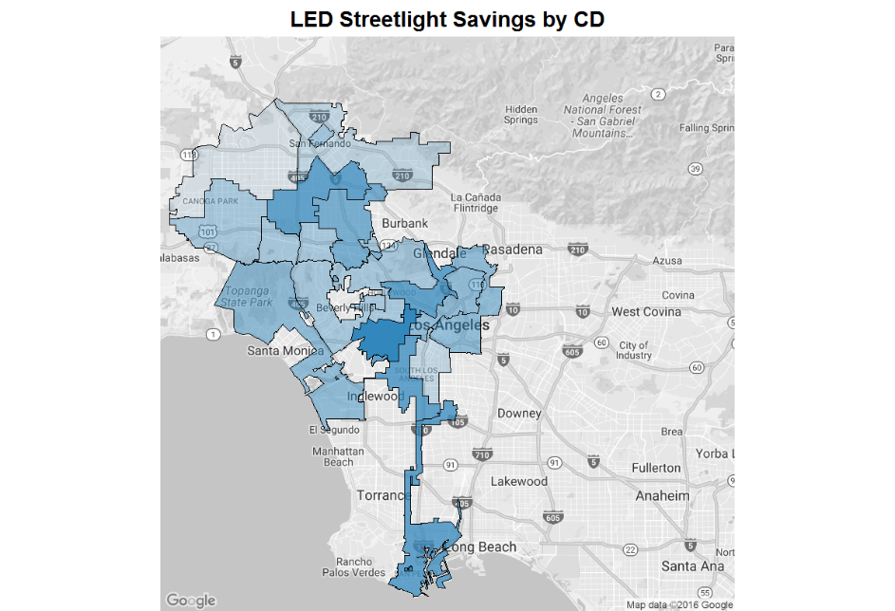
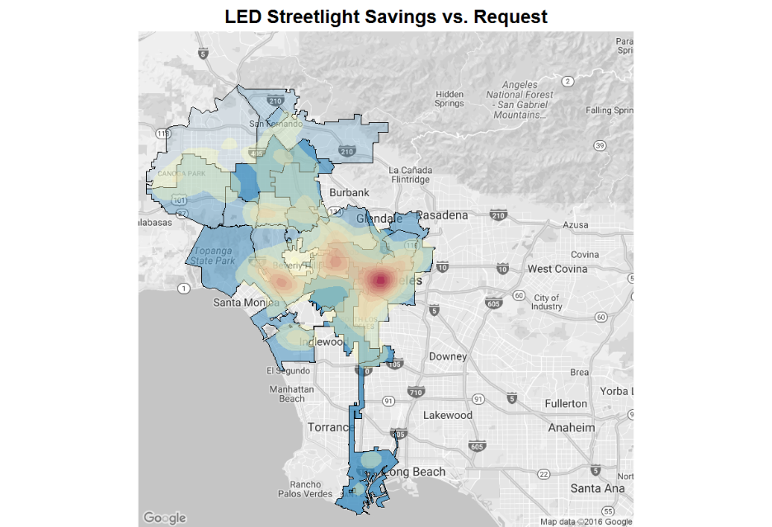
LED Streetlight Plan
LED Streetlight Program
LED Streetlight Savings by CD
LED Streetlight Savings vs. Requests
1
Basic
Distribution
2
Time Series
Efficiency
3
Map with
Real-time Data
4
Smart LA
Suggestions

Slide 31
Smart LA
Suggestions
04

Slide 32
Smart Suggestions
1
Continue to drive traffic to MyLA311 Mobile App.
2
Identify request types with long handle times and optimize resource allocation to improve 311 service efficiency.
3
Connect 311 data set with other department datasets to foster more collaboration between agencies.
市场调查=调查目标+调查方法+调查问卷+注意事项
举例
1
Basic
Distribution
2
Time Series
Efficiency
3
Map with
Real-time Data
4
Smart LA
Suggestions

Slide 33

Smarter LA
Smarter Lives

Slide 34
Backup Slides

Slide 35
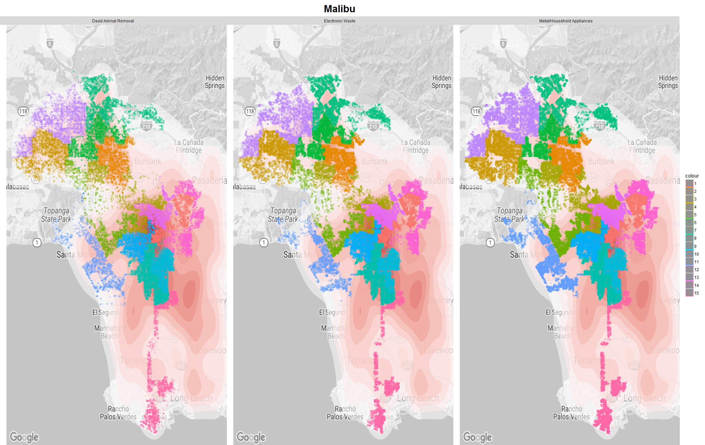
Special features
Overview
Basic Distribution
Time Series/Efficiency
Maps
City Planning
Summary

Slide 36
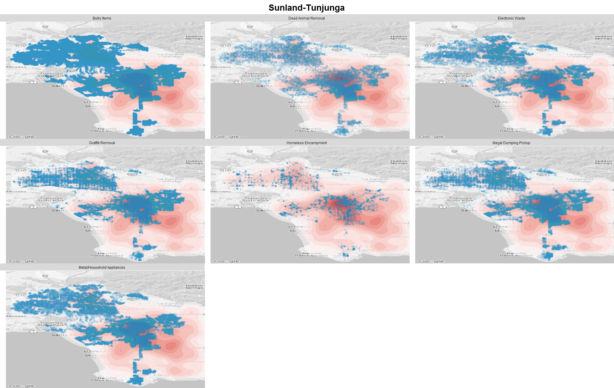
Abnormality
Overview
Basic Distribution
Time Series/Efficiency
Maps
City Planning
Summary

Slide 37
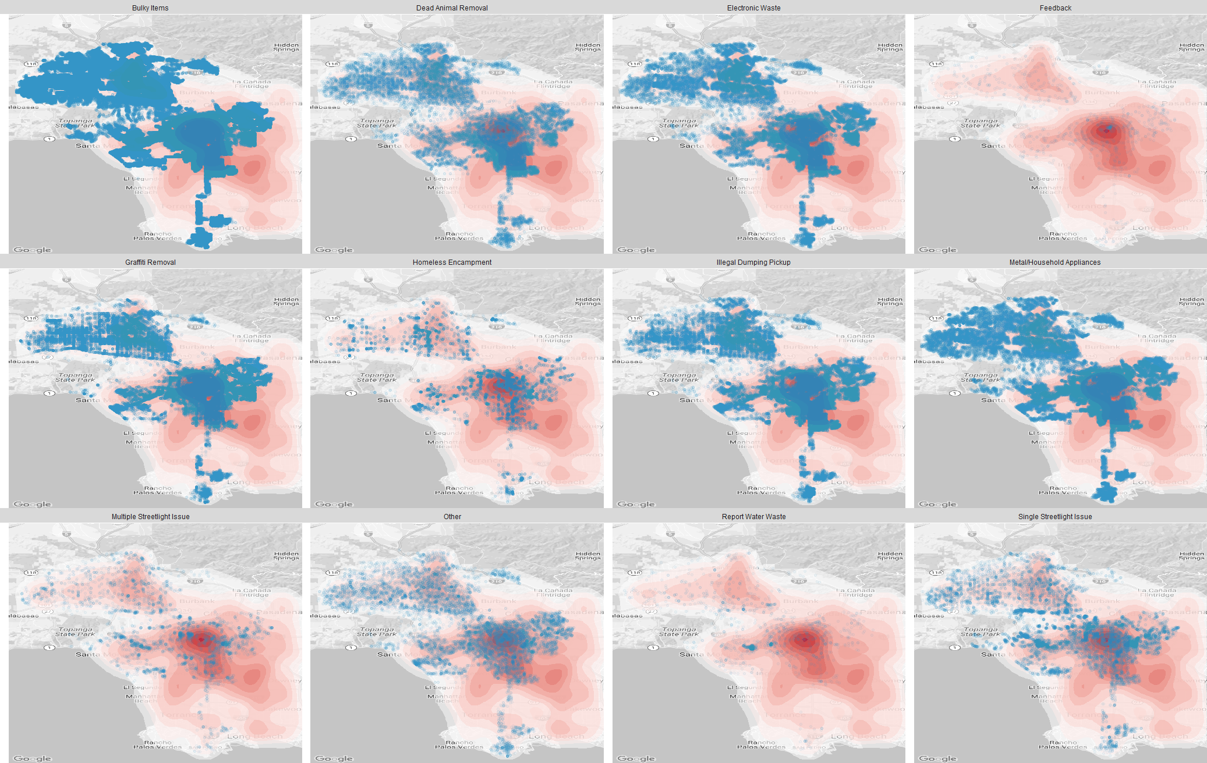
Breakdown in population map
Overview
Basic Distribution
Time Series/Efficiency
Maps
City Planning
Summary

Slide 38
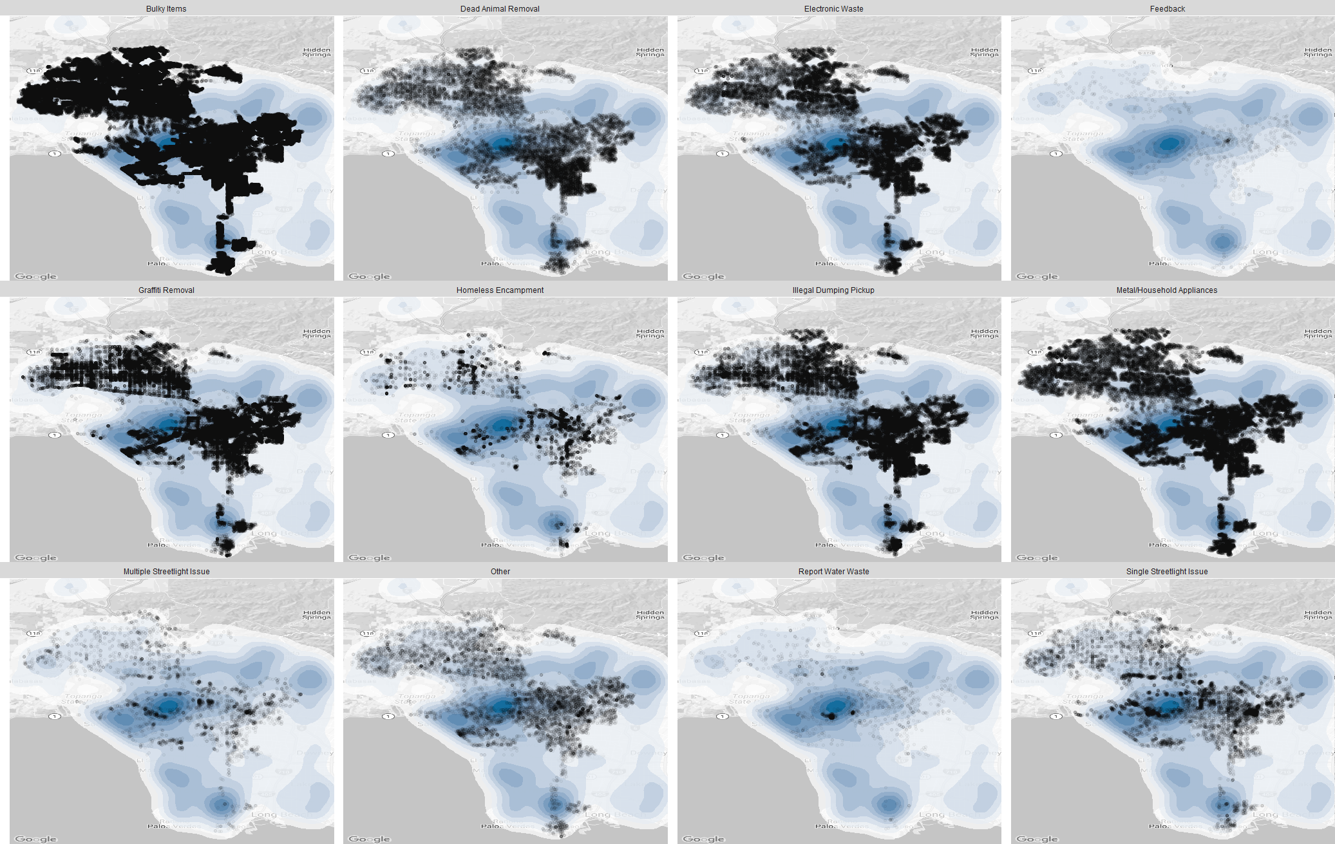
Breakdown in income map
Overview
Basic Distribution
Time Series/Efficiency
Maps
City Planning
Summary

Slide 39
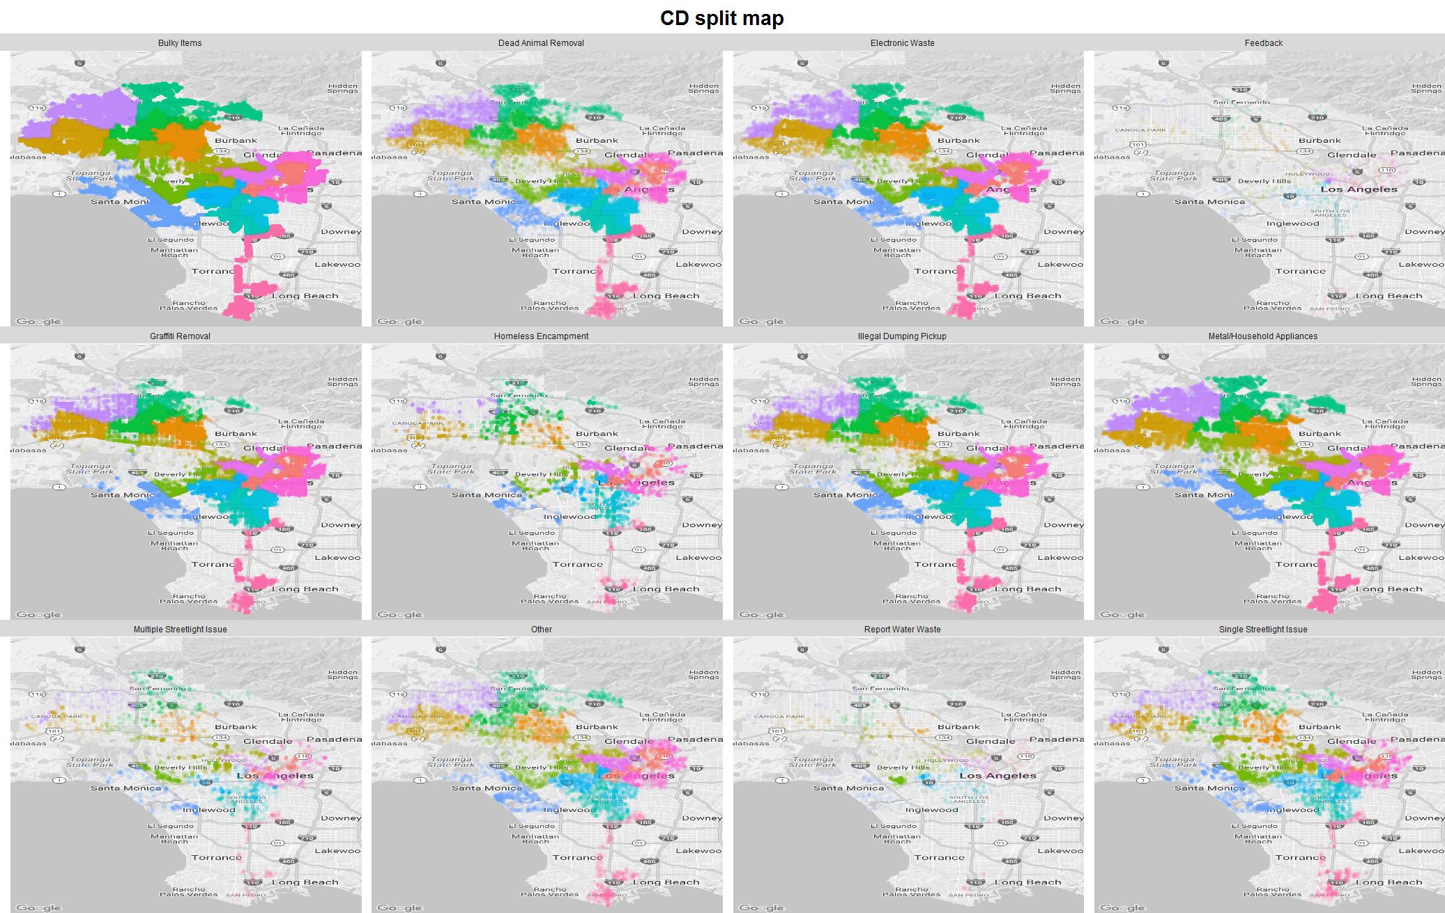
Breakdown in council map
Overview
Basic Distribution
Time Series/Efficiency
Maps
City Planning
Summary

Slide 40
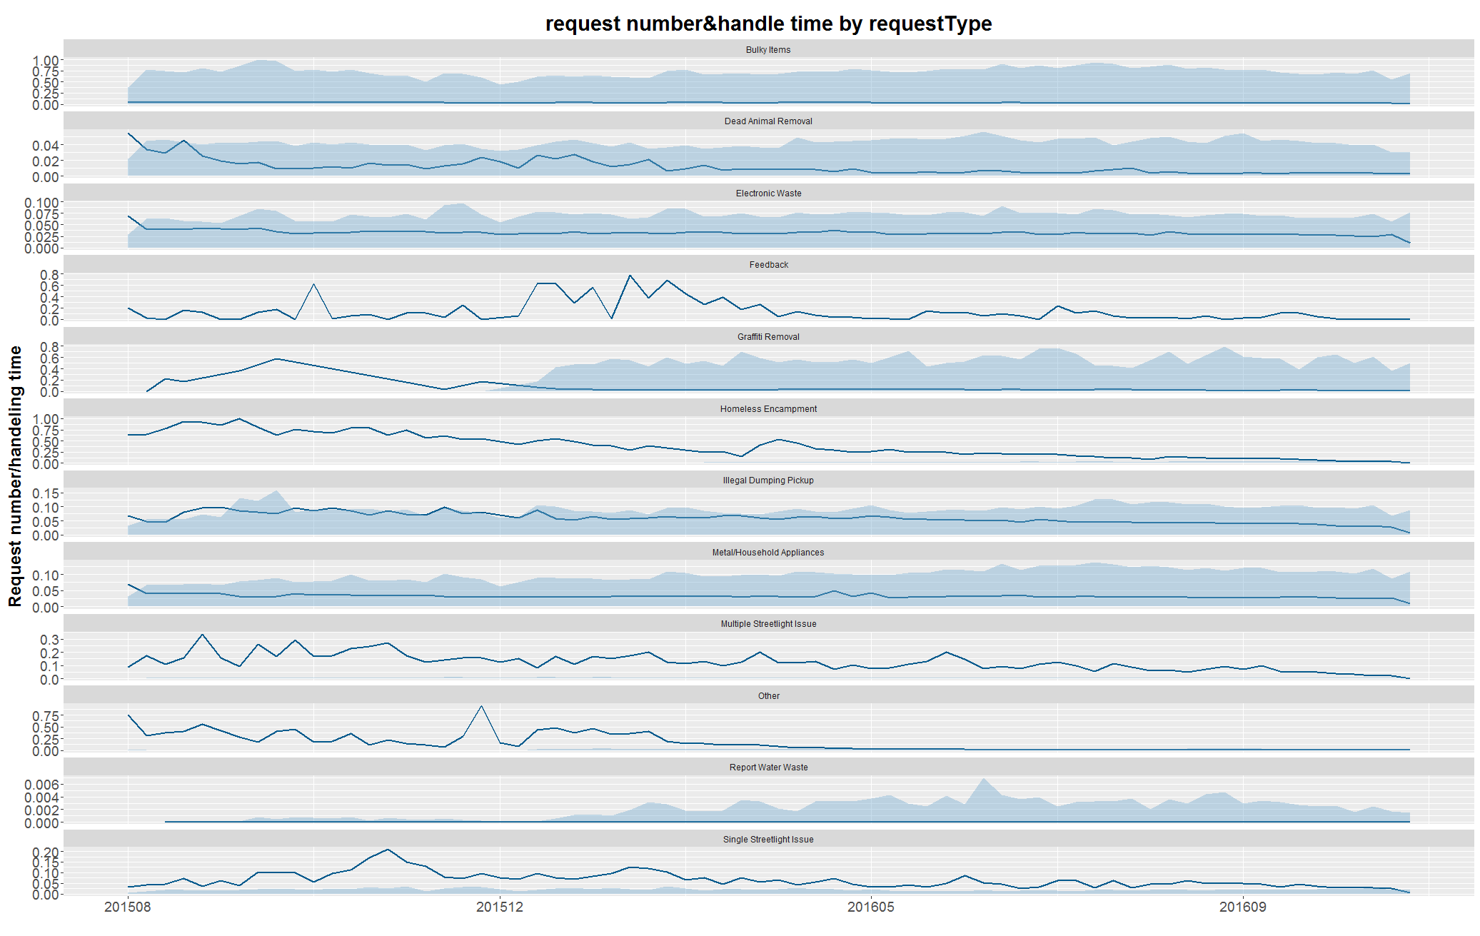
Breakdown exploration
Overview
Basic Distribution
Time Series/Efficiency
Maps
City Planning
Summary

Slide 41
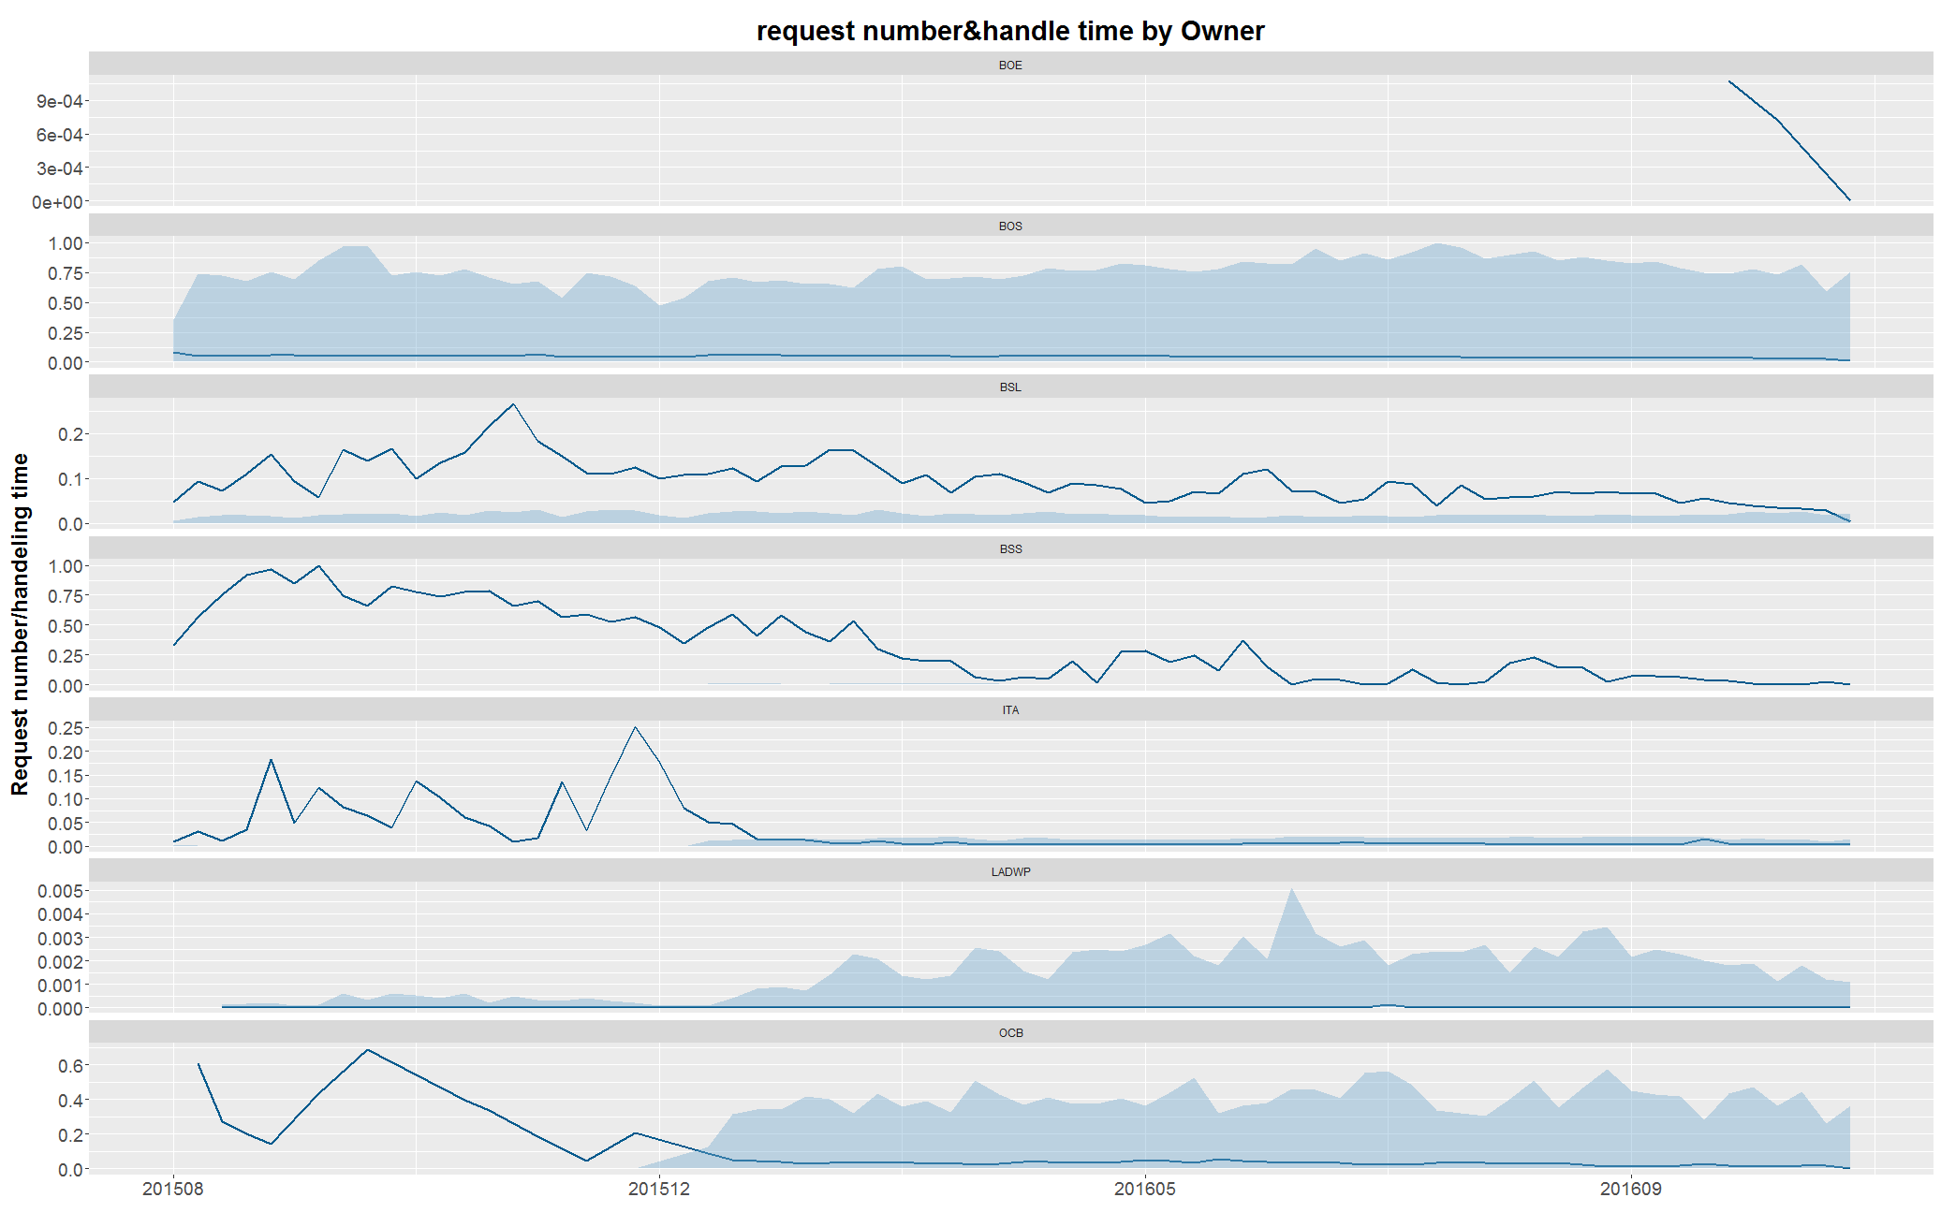
Breakdown exploration
Overview
Basic Distribution
Time Series/Efficiency
Maps
City Planning
Summary

Slide 42
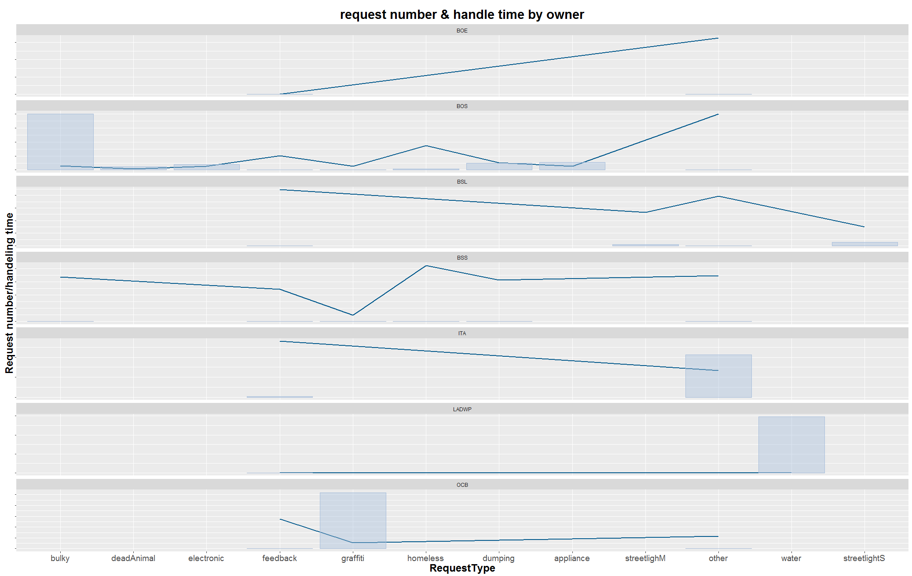
Breakdown exploration
Overview
Basic Distribution
Time Series/Efficiency
Maps
City Planning
Summary

